Slide 1
An Overview of the Science of Climate Change
Chris Barnet, Ph.D (Planetary Atmospheres)
Science and Technology Corporation
Columbia, Maryland
Friday August 30, 2019
Presented at: Howard Univ. Beltsville Campus
Fall Seminar Series (ATMS 301)
Notes:
1:00 at Howard Univ. Beltsville Campus
Title: An Overview of the Science of Climate Change
Abstract: Chris Barnet will provide a summary of the recent
publications on climate change. The presentation will be an
overview of 100's of scientific papers published since the last IPCC
assessment in 2013. Topics will include recent climate change
modeling predictions, recent measurements of climate change as well
as Chris' personal impressions of how the topic of climate change
has evolved in recent years. Chris hopes to engage the audience
with a broad brush of topics and then lead an impromptu conversation
on any or all of these topics.
Bio: In his early career, Chris Barnet modeled planetary atmospheres
and used Voyager Spacecraft and Hubble Space Telescope sensors to
understand the climate of Jupiter, Saturn, Uranus, and Neptune. For
the last two decades, he has developed algorithms for monitoring the
Earth's weather and climate from advanced Earth-orbiting sensors. He
is presently a Senior Research Scientist at Science and Technology
Corp. (STC), Columbia Maryland and is the NASA Sounder Discipline
Lead for the Suomi-NPP satellite as well as the NOAA/JPSS Senior
Advisor for Atmospheric Sounding.
f/ Dave Whitemans, July 30, 2019
What I present to the students will draw from the executive summaries
of those two volumes - I may just cover the big blue bubbles. Haven't
put that material together yet though but it sounds like we're on the
same page for preparation.
For me personally I would be very interested to have you also discuss:
1) current research on climate sensitivity factor (delta T for
doubling of CO2) a few years back I seem to recall that you
presented a histogram of possible values that actually included a
small number of negative ones (how can that be?). What is the
research now?
2) In a previous talk you discussed economic analysis of conversion to
a net 0 carbon world (I think that was it). The result was global
decrease in GDP approximately the same as the 2009
recession. What's the latest on that?
3) It is always interesting to consider the top few climate skeptic
arguments and their rebuttals. Could you include some?
That's my personal wish list if you have the time. Looking forward to
it. Thanks.
Wuebbles, D.J., D.W. Fahey, K.A. Hibbard, D.J. Dokken, B.C. Stewart
and T.K. Maycock 2017. Climate Science Special Report: Fourth
National Climate Assessment, Volume I. U.S. Global Change Research
Program doi:10.7930/J0J964J6, 470 pgs. PDF FILE =
~/climate/review/nca/1711usgcrp_nca4_v1.pdf
Reidmiller, D.R., C.W. Avery, D.R. Easterling, K.E. Kunkel,
K.L.M. Lewis, T.K. Maycock and B.C. Stewart 2018. Impacts, risks, and
adaptation in the United States: Fourth national climate assessment,
volume ii: report-in-brief. U.S. Global Change Research Program
https://nca2018.gl obalchange.gov, 186 pgs. {PDF FILE =
~/climate/review/nca/181122nca4_vol 2.pdf}
Wed. June 6, 2018 GCAN talk
~25 showed up (Peter Leigh was there)
Started with Sterling Colgate story, did CO2 slide – CO2 stays in atmosphere for 10,000 years
1st question jumped to solutions
- bury wood
- (mafic rock) and then jumped around
1000 bbl’s of oil
morality slide
other planets slides
comes down to economis -- Leave trillions in ground
Ener-net
USA could be 100% renewable -- example MD
global warming theory -- Happer and OSTP
recently focus my talks on high schools
- I ask question like why should we save the Amazon and they get it
- people over 20 do not
- they are about to be consumers and
1) will make long-term decisions on things like houses, cars
2) they will get jobs -- make choices there also
3) and they will be voting -- need to know enough science
future directions of my talk (Commoners vs. Elites)
ended up on ... building graphic
Provided ~20 hand outs of graphic
Did not do update slides
Idea for next talk --- CO2 figure
- any solution would have to be noticeable on this graphic
- 2008 economic downturn was barely noticeable
- achieving c-neutral would make it flatten out
- removing CO2 from atmosphere would make it reduce
Idea for next talk --- solutions
Carbon free energy system, all energy pays full market cost – must tax C and return full amount as energy dividend.
Dividend will discourage consumption of fossil fuel and drive technology and C-neutral solutions, people will move from fossil
Increase tax on fossil as a function of time – siphon dividend towards sequestration solutions. There are 100’s of ideas – some work “at scale” others do not – explore them all
Find solutions that are economically sustainable.
Previous GCAN talks
11/7/2007 – assembled climate panel
3/12/2008
2/11/2009
11/11/2009
9/27/2015 Teach in on inter-faith, encyclical
2/ 3/2016
Chris Barnet will provide an entertaining summary of the recent science of climate change. The presentation will be an overview of 100's of the most recent scientific papers. Topics will include recent climate change modeling predictions, recent measurements of climate change as well as Chris' personal impressions of recent climate change talks he has given in local high schools. Chris hopes to engage the audience with a broad brush of topics and then lead an impromptu conversation of any or all of these topics. Chris Barnet has lived in Greenbelt for over 25 years. In his early career, he modeled planetary atmospheres and used Voyager Spacecraft and Hubble Space Telescope sensors to understand the climate of Jupiter, Saturn, Uranus, and Neptune. For the last two decades, he has developed algorithms for monitoring the Earth's weather and climate from advanced Earth-orbiting sensors. He is presently a Senior Research Scientist at Science and Technology Corp. (STC), Columbia Maryland and is the NASA Sounder Discipline Lead for the Suomi-NPP satellite as well as the NOAA/JPSS Senior Advisor for Atmospheric Sounding.
Annual update:
p. 4,5, Hansen’s fig a2
pg. : N.H. Extent Anomalies from NSIDC Sea ice Index page:
http://nsidc.org/data/seaice_index
pg. 31 personal carbon footprint
Print menu, Select: Note Pages, 1pg/pg (not an option) DO NOT Check include comments
In Properties: 2 page/page (portrait)
..or for more condensed.. In properties: 4 page/page, advanced:set scale to 88%
Or for simply the slides print “slides” w/ scale to fit=ON
- click on {properties} in upper right corner
- In {layout} set orientation to landscape mode and 16 pages per sheet
- click on advanced, set paper size = screen)
- then load PDF in acroread, reprint the resulting PDF file to 8x10 size (fit to printable area option in acroread)
University of Maryland, Baltimore, Date/Time: Feb. 14, 2017 11:00-12:00
Attending: ~12 students, Belay Demoz, Susan Hoban, Vanderlei Martins, 1 other
Start: ~11:05 End:12:02
Questions: 1) Belay: why do you keep track of details like gasoline
before I could tell others what to do, I wanted to understand
what I was doing
2) Student: are taxes a good idea?
Hansen’s tax idea vs. cap-and-trade
-----------------------------------------------------------------------
Feb. 3, 2015 Greenbelt Climate Action Network
ANNUAL CLIMATE CHANGE UPDATE with Chris Barnet
7:00 - 9:15 pm, Greenbelt Community Center, Room 114, 15 Crescent Road, Greenbelt, MD
~10 people Chris Nichols, Eric T. Norwood (ericnorwood27@yahoo.com),
Millicent Allenby (mitallenby@gmail.com)questions about east coast oil vs. wind, sent her the Kempton papers, Lore Rosenthal, Jon B. Sellin (jbsellin@aol.com, geologist – “got it mostly right”)
Things to add:
Discussion on ENSO mechanism, storage of ocean heat
Scale of problem: 100-Gt versus 1 Gt solutions are needed
Problems with Nuclear – do we really need it
---------------------------------------------------------------------------------
Sep. 28, 2015 Catholic Univ. (Sus.Arch) ~ 60 students (focus on Encyclical)
Talked from 9:40-10:30
Introduction to Sustainability course to our sophomore students
Mondays and Wednesdays from 9:40 – 10:55 am
class is 70 minutes
55 undergraduates and 6 graduates
Chris Grech, RIBA, Associate Professor, Center for Building Stewardship, Director Master of Science in Sustainable Design Program Director, The Catholic University of America School of Architecture and Planning, 620 Michigan Avenue NE Washington, DC 20064 USA T: 202-319-6398 <tel:202-319-6398> E: grech@cua.edu <mailto:grech@cua.edu>
W: http://architecture.cua.edu/academicprograms/MSSD.cfm
Vatican astronomer Guy Consolmagno
PhD from Arizona, Harvard fellow, NASA/GSFC visiting scientist, meterorite researcher, winner of the 2014 Carl Sagan Medal.
<a href="http://thecolbertreport.cc.com/videos/zwjey6/gold--frankincense-and-mars---guy-consolmagno"
target="_blank">2009, on Stephen Colbert</a>
Consolmagno has worked for John Paul II, who ordered the teaching of evolution in all Catholic schools, for Benedict XVI, who commissioned the report on climate change from the Pontifical Academy of the Sciences which led to Francis elevating the destruction of the climate to a moral issue. Benedict is actually known as "the Green Pope," because he did most of the groundwork for what Francis just wrote.
Bill Dinges, colleague from CUA School of Theology
teaches a course called Religion and Ecologyy
Questions:
Chris G.: what did you think of the encyclical?
A: My talk shows how difficult this problem is and how it will cost a lot and we basically get nothing in return except lowering the risk for future generations. So I think the encyclical fills a critical need to say that returning the Earth to how we found it is a moral obligation.
Student: Solar and wind is not carbon free.
A: I agree, there are issues with solar as to carbon emissions from the ground that the arrays cover. Plus there are carbon costs in production. But you have to look at the full life-cycle carbon. Relative to coal the life-cycle carbon cost is negligible.
Student: At what point is there no return?
A: There is a lot of discussion on this, but I think the answer is basically never. As we get to 2050 and beyond the effects will be more apparent and people will act, but it will be more difficult and cost more.
Student: you said that your generation caused the problem but your generation has also given us many tools and ideas that will help us solve th problem.
A: yes, but as a scientist we were aware of this in the 1960’s but continued to emit carbon. Recognize that the theory was done in the 1890’s and by the 1930’s was accepted and in the 1950’s was actually measured. So I would not be so forgiving.
Bill D.: Heard that encyclical only includes science that was accepted. Was this true?
A: yes, in fact I have shown a slightly more pessimistic view because that is what scientists are wrestling with today. The Encyclical and the IPCC only discusses published and confirmed results and as a result don’t factor in a lot of the potential risks.
Student: I haven’t heard the agricultural points before, is that new?
A: No, it is not new. It takes up ~500 pages {probably an exaggeration) in the IPCC and there are many scientific papers on this topic. The reason you have not heard it before is because our media prevents objective discussion on this topic. If you have a climate scientist on the news they are always accompanied by a non-climate specialist and they will say CO2 is green and CO2 is good for plants. You can’t have a discussion on agriculture because it becomes an argument before anything meaningful can be said. It is a hot topics in countries like India and China and in the USA we are not concerned because we are a wealthy country. But it might be a good idea to be friendly with the Canadians.
---------------------------------------------------------------
Feb. 3, 2015 Greenbelt Climate Action Network
Sep. 28, 2015 Catholic Univ. (Sus.Arch) ~ 60 students (focus on Encyclical)
Sep. 17, 2014 Catholic Univ. (Sus.Arch) ~ 60 students
Sep. 23, 2013 Catholic Univ. (Sus.Arch) ~ 60 students
Oct. 3, 2011 Catholic Univ. (Sus.Arch) ~ 100 students
Sep. 23, 2010 Catholic University, Sustainable Architecture Class, 105 students
Sep. 17, 2010 Catholic University, Alternative and Renewable Energy Class, 9 students
Apr. 15, 2010 Howard University, Beltsville Campus, Atmospheric Science Class (2.5 hours), questions at end
Nov. 11, 2009 GCAN meeting, Greenbelt Community Center, ~ 15 people (for slides search for’top 10 “discoveries” in 2009’)
Sep.28, 2009 Catholic University, Sustainable Architecture Class – reply to skeptical arguments - ~140 students attended
Sep. 4, 2009 Catholic University, Renewable Engineering Class, ~25
Apr. 22, 2009 Catholic University, Earth Day event ~ 200
Apr. 9, 2009 UMCP AOSC 434/658 2:00-3:15 CSS 2416
Feb. 11, 2009 GCAN meeting, Greenbelt Community Center
Sep. 10, 2008 Catholic University, Architecture class
May 29, 2008 Robert Goddard French Immersion School, 8th grade science class.
Mar. 12, 2008 Greenbelt Climate Action Network, Greenbelt Comm. Center
Feb. 29, 2008 Berwyn Heights Elementary School, 6th grade class
Jan. 31, 2008 Oxon Hill High School – Focus the Nation Event
Nov. 7, 2007 Greenbelt Town Hall Meeting

Slide 2
Some comments on this presentation
Goal of this talk:
To provide a scientific basis for your understanding of global warming and climate.
To provide you with scientific references.
I would prefer you ask questions as they arise.
Slides are dense – I will only cover highlights.
The notes section (below slides) of this powerpoint includes scientific references and/or calculations
These give you the source of every statement I am making on these slides.
There are also additional slides at the end.
Notes:
Tell story of Sterling Colgate from ~1989 meeting
https://en.wikipedia.org/wiki/Stirling_Colgate
Stirling Auchincloss Colgate (November 14, 1925 – December 1, 2013) was an American physicist at Los Alamos National Laboratory and a professor emeritus of physics, past president at the New Mexico Institute of Mining and Technology (New Mexico Tech) from 1965–1974 and an heir to the Colgate toothpaste family fortune.
1952 moved to Livermore National Laboratory, worked for Edward Teller, diagnostic measurements for their nuclear H-bomb tests.
1956 Colgate studied X-ray and gamma-ray from supernova’s and how they could set off satellites designed to detect hydrogen bomb explosions.
Colgate found that neutrinos can develop degeneracy pressure. This pressure aided the shock wave in blowing off the outer shells of an expiring star, leaving a neutron star behind
Colgate went on to serve as the president of New Mexico Tech in Socorro NM from the beginning of 1965 through the end of 1974. Research programs in astrophysics and atmospheric physics as well as leading the college
From 1975 until his death, Colgate worked at the Los Alamos National Laboratory (LANL) and was a professor emeritus at New Mexico Tech

Slide 3
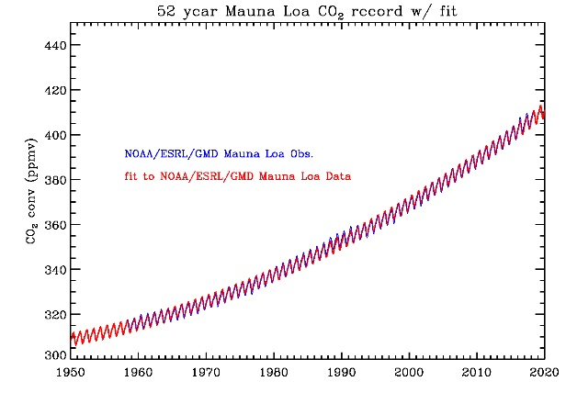
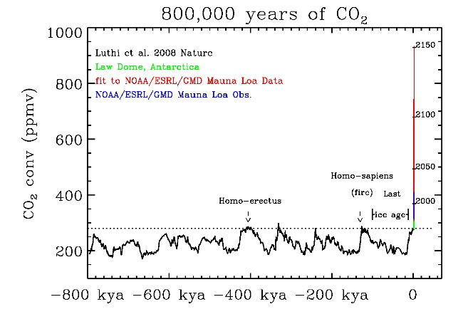
Very high-certainty (99%) that atmospheric CO2 is increasing
For ≈2 million years CO2 has been below 300 ppm
1960 meeting in Finland, consensus was CO2 increase due to humans could not be measured
A skeptic, C. David Keeling (hired by Roger Revelle) showed his first 2 years of measurements.
1958 began “background” measurements at Mauna Loa
Needed to make precise measurements every 4 hours
We now know with very high certainty that growth in atmospheric CO2 is due to burning of fossil fuel and burning of old forests (≈15%)
Based on analysis of ¹³C and ¹⁴C isotopes
Seasonal (+/- 3 ppm) and inter-annual (+/- 1 ppm) cycles are mostly due to changes in biology
2018 global CO2 increase was 2.43 ± 0.08 ppm/y
Average of last decade (2009-2018) was 2.28 ppm/y
Notes:
2017 global mean and increase is from NOAA Globalview site
Money market at NASA FCU is 0.3%
Lower right figure, CO2 is from Ethridge 1998 using Law-Dome Antarctica where there is rapid snow accumulation
Sep. 2014 WMO GHG Bulletin: annual mean = 396.0 +/- 0.1 ppm, 2012-2013 annual mean growth was 2.9 ppm (largest since 1984)
http://www.esrl.noaa.gov/gmd/ccgg/trends/global.html
Year growth uncertainly
2010 2.39 0.06 ppm/y
2011 1.71 0.09
2012 2.37 0.09
2013 2.54 0.09
2014 1.85 0.09
Roger Revelle hired Charles Keeling in 1957 (Al Gore 2006)
(Volk 2008 MIT): story about Keeling at Finland meeting
(Pearce 2007 Beacon Press) : began in mid-1950's in Yosemite Nat'l Park, every 4 hours at Mauna Lao, missed birth of 1st son in order to avoid gaps in logbook
Charles Keeling is survived by Louise, his wife of 50 years, and by his children Andrew of Zurich, Switzerland; Ralph of La Jolla, Calif.; Emily of Boulder, Colo.; Eric of Missoula, Mont.; and Paul of Vancouver, British Columbia (Scripps obit)

Slide 4
CO₂ concentrations are now 43% larger (410 ppmv) than at any time during the last 800,000 years.
410
?
time
Analysis of Dome-C (and Vostok) Antarctic ice-cores show that the CO₂ in the atmosphere responded to changes in Earth’s temperatures (orbital and vegetation feedbacks). Will these feedbacks will play a role in modern climate change where temperature responds to CO₂?
Deuterium change (δD(o/oo) is a proxy for temperature (lower panel)
Note: Given the inertia of the climate system, we will probably miss the next glacial cycle completely due to global warming.
Notes:
Miss next glacial cycle:
- Determining the length of the current interglacial (Tzedakis 2012 Nat.Geo)
- Won't be another glacial for 100,000 years (Ganopolski 2016 Nature)
- An Exceptionally Long Interglacial Ahead? (Berger 2002 Science)
2019 ~411 ppm average global CO2 (from NOAA ESRL)
(410-285)/285 = 43.86%
NOTE that temperature preceded CO2 and this may be a weathering or biosphere feedback.
With global warming we are increasing CO2 and temperature may lag.
Paleoclimate, CO2 lagged T by few hundred years but is highly correlated – Fig from Hansen PNAS 2003.
Tyrrell 2007 Tellus – may completely miss next glacial, 650,000 yr ice core motivated by understanding interglacial at 430,000
Lake Vostok 420,000 ice core is 11,890 feet long (3624 meters)
Brook 2005, Science v.310 p. 1286 has nice summary of Fig from Seigenthaler (d18O,CO2) and Spahni (CH4,N2O)
Old figure is from Fig. 4 - Seigenthalar 2005 Science Dome Concordia ice core (75d 6’ S, 123d 21’ E, 3233 meters a.s.l.),
motivation was to study 430,000 yrs ago – orbital element analog Tyrrell 2007 Tellus]
New figure is from 3270 meter ice core at dome-C [Luthi 2008 Nature]
d18O is a proxy for temperature: 18O is heavier it evaporates less rapidly and precipitates more rapidly, that is 18O/16O = f(T)

Slide 5
Let’s convert CO₂ emissions into something more tangible
5-lb bag has ≈ 100 briquets
20 briquets/pound (44 briquets/kg)
Each briquet is ≈ 0.05 lb of carbon
From Paul Roberts 2004 “The End of Oil; On the Edge of a Perilous New World” – Original idea attributed to Gerry Stokes at UMCP.
Note: in reality, briquets are made from wood - which is sequestered carbon from the atmosphere – so when burnt they are carbon neutral (on the 100 year scale).
So these briquets really represent the carbon-equivalent of fossil carbon

Slide 6
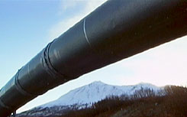
Gasoline
Regular gasoline is composed of
87% Octane (C₈H₁₈)
13% Heptane (C₇H₁₆)
1 gallon of gasoline weighs 6 lbs
84% of gasoline is carbon
5.05 lbs-carbon per gallon ➔ 100 briquets/gallon
240 million registered drivers in the USA
34 million SUV’s & 39 million pickup trucks
Multiply by miles/day
Toyota Prius | 50 m/g | 2.0 brig/mile
Toyota Camry | 30 m/g | 3.3 brig/mile
Honda Odyssey | 25 m/g | 4.0 brig/mile
Ford F-150 | 17 m/g | 5.8 brig/mile
Chevy Suburban | 14 m/g | 7.1 briq/mile
Notes:
137.7E6 passenger cars in 2003, 89.2E6 in 1970
2.6E6 miles of paved roads in 2003, 1.7E6 in 1970 → 27,272 miles/yr
alters sensible and latent heat fluxes, reduces sequestration of CO2 2.6E6/285E6 = 0.0091 mile/person = 48 feet/person
48 states has 112,610 +/- 12,725 km^2 of impervious surface area in 2000 [EOS 6/15/2004] 112,610,000,000/279583437 = 402.8 m^2 = 20x20 meters = 60’ x 60’ per person
Approx. size of Ohio (116,534 km^2) is paved – prevents C sequestration, urban heat island effect 0.010 mile of road/person = 48’ per person, 1 acre = 4046 meter^2 = (208.78 ft)^2
300 million people in USA in Oct. 2006
2000: 50 states: 281,421,906 48 conterminous: 279,583,437
1990: 50 states: 248,709,873 48 conterminous: 247,051,601
1980: 50 states: 226,545,805 48 conterminous: 225,179,263
Carbon is 8x12/(8x12+18)=84.2% of octane and 7x12/(7x12+16)=84% of heptane
Carbon is 0.87*84.2+0.13*84=84% of a gallon of gasoline
EPA: Trucks at 600 rpm idling 0.48 gal/hr @ 1200 rpm 1.21 gal/hr

Slide 7
Coal (≈ C₁₃₅H₉₆O₉NS+) is 85% Carbon
1465 coal plants in USA
34% of USA emissions
45% of USA electricity (2009)
59% are older than 42 years
Gases released
CO2: 170 t-C/h
SO2: 6.7 t-SO2/h
NOx: 1.0 t-NOx/h
Electricity: 0.5 GW (500 MJ/s)
Heat & Losses: ≈1 GW (1170 GJ/s)
2 gondola cars/hour
200 t-coal/h⋅30 MJ/kg = 1670 MJ/s
Ash: 30 t/h of
Mercury & Arsenic
5.2t-U/yr
74 lb U-235/y
12.8 t-Th/yr
Fort Martin, WV
Notes:
Chalk Point: Net summer capacity: 2,415 MW, Steam units: Units 1 & 2: coal-fired Units 3 & 4: oil-and-gas fired , Combustion turbines: Units 1& 2: oil-fired Units 3, 4, 5, & 6: gas-and-oil fired
Coal ≈30 MJ/kg = 3 times wood
200,000 kg-coal/h * 30 MJ/kg / 3600 s/h = 1670 MJ/s
Coal is 85%C by mass so that 200,000 kg-coal = 170 t-C/h = 623.3 t-CO2/h = 1,371,333 lb-CO2/hr = 2740 lb-CO2/MWh
In 1-hour a 500 MW plant will produce 500 MWh
Assume 33% efficiency (Lackner 1998 Science, Pacala 2004)
Pepco 1167 lb-CO2/MWh generated * 1/0.33 * 1/0.6-coal/gas/oil = 5893 lb-CO2/MWh
Ash is 13% of coal
C135H96O9NS = 12*135 + 96 + 16*9 + 14 + 32 = 1906 g/mole
%C = 12*135/1906 = 85%
%S = 32/1906 = 1.68% (Li 2010 GRL 10-38 kg-SO2/t = 1.0-3.8%, 64/1906 = 3.4%)
200 t-coal/h * 32/1906 * 64-SO2/32-S = 6.7t-SO2/h
Pepco = 5.7 lb-SO2/MWh = 5.7*500 MWh/0.33/2200 = 3.9 t-SO2/h
Pepco = 1.4 lb-NOx/MWh = 1.4*500 MWh/0.33/2200 = 1.0 t-NOx/h

Slide 8
Electricity
PEPCO (Potomic Electric power company):
~60% of Maryland electricity is generated from fossil fuel
1108 pounds of CO₂/mega-Watt-hour generated (2014 PEPCO statement)
1.108 pound/kilo-Watt-hr * 20 brig/pound * 12/(12+32) C/CO₂ = 6 briq/kWh
Equals 6 Briquets of Carbon emitted (at the power plant) into the atmosphere Assume ≈25% transmission loss ➔ 7.5 Briquet per kilo-Watt-hour consumed
Average PEPCO customer in 2006 used
NYC peak demand is 11 GigaWatts = 75 million briquets/hour
Ft. Martin, WV
1100 MW Plant
year | coal | gas | oil | nuclear | Renewable | Pound/MWh | Briq/kWh
2007 | 54.7% | 7.3% | 0.5% | 33.4% | 4% | 1241 | 6.77
2014 | 43.5% | 17.5% | 0.3% | 34.7% | 4% | 1108 | 6.04
2018 | 28.7% | 31.1% | 0.2% | 34.5% | 5.5% | 924 | 5.04
Washington DC | 790 kWh/month | 26.0 kWh/day | 195 briq/day
Maryland | 1124 kWh/month | 37.5 kWh/day | 280 briq/day
Notes:
145 Watt* 1 hour = 145 J/s * 3600 s = 522 kJ/Briquet
11 GW = 11,000,000 kWh/h * 6.9 briquet/kWh = 75 million briquet’s/hour
For example, Fort Martin, WV burns bituminous coal (500 MW) near Martinsburg, WV
Owner/Parent Company: Allegheny Energy
Plant Nameplate Capacity: 1,152 MW
Units and In-Service Dates: 576 MW (1967), 576 MW (1968)
Location: Rte. 53, Maidsville, WV 26541
GPS Coordinates: 39.710611, -79.927806
6,038 GWh/yr (6366 hours/yr), <0.947> GW plant, 6624 kilo-ton CO2/yr, 2194 lbs CO2/month
uses 2 full train-car loads of coal (100 tons/car) per hour going in, 6 train-car loads of CO2 going out (Hemsath 2007)
Average of my electric bill (1996-2008) is <1139> kWh/month or <37.5> kWh/day for a family of 4 in 1000 sq.ft home

Slide 9
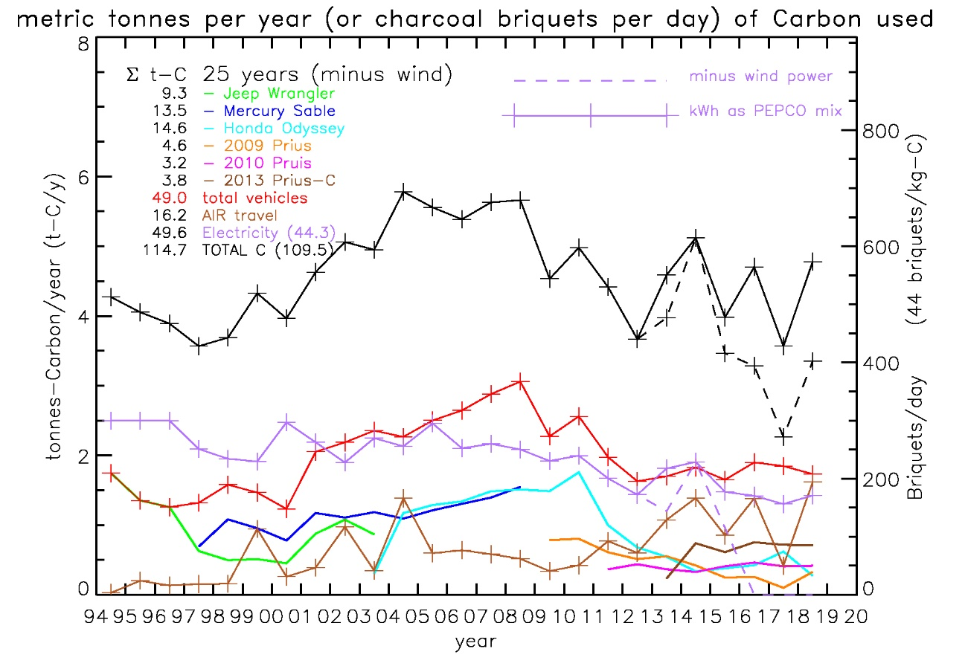
My personal carbon footprint (does not include indirect emissions)
Does include efforts to reduce consumption
changing to CFL light bulbs (2008-2010)
Does not include “indirect” footprint due to manufacturing, shipping, agriculture.
Biggest impact (so far)
Replacing vehicles with hybrids and driving less.
25% reduction due to PEPCO’s transition from coal to nat’l gas
Air travel is cause of recent increase
Kids
Prius
1 tonne-C/year ≅ 120 briquets/day
My family of 4 household energy (electricity & heat) use is about the same as total transportation, each ≅ 250 briquets/day
Indirect emissions (food, work/businesses, etc) would easily double our emissions
Notes:
6 t-C/y * (1000 kg/t * 44 briq/kg)/ (365 day/y) = 723 briquets/day
Prius #1 Jan. 3, 2009
Prius #2 Jan. 8, 2011
Prius #3 Aug.17, 2013

Slide 10
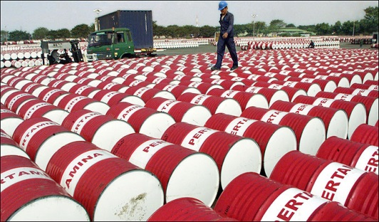
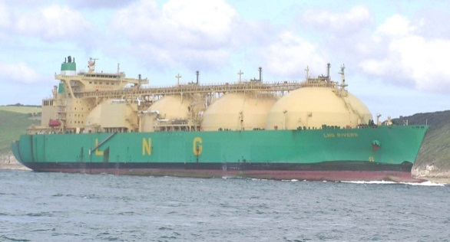
Worldwide we are emitting more than 9 billion tonnes of carbon/year
Oil | Coal | Gas | Deforestation
2.9 Gt-C/yr | 3.0 Gt-C/yr | 1.5 Gt-C/yr | 1.6 Gt-C/yr
1 Exxon-Valdez per minute | 4000 tons per second | 100,000 billion cubic feet | 4 acres/second
1000 barrels per second | 37 Train loads per second | 1 Liquid Nat’Gas Tanker per minute | 330 cords per second
1000 bbl-eq/s | 740 bbl-eq/s | 575 bbl-eq/s | 180 bbl-eq/s
348 billion briq/day | 360 billion briq/day | 180 billion briq/day | 192 billion briq/day
To remove 1 years worth of CO2 from the air will take a similar effort.
1 Gt-C/yr = 1 billion-tonnes-C/yr = 120 billion-briquets/day
Notes:
1 bbl oil = 6.119E9 J
1 tonne coal = 2.929E10 J (29.29 kJ/g) 4.787 bbl-eq/tonne
1 m^3 N'gas = 3.726E7 J 0.00609 bbl-eq/m^3
wood is 12 kJ/g or 1/3 the energy content of coal 1.6 bbl-eq/tonne-wood
1 Gt-C/y = 1000 G-kg-C/y/(365 day/y)*(44 briq/kg) = 120 billion-briquets/day
85 million bbl's/day = 983 bbl/sec
42.5 Saudi Sirius Star (2 million bbl's) oil tankers/day
85 MB/d / 1.48 MB/exxon.valdes = 57.4 exxon.valdes/day or 1/minute
85,000,000 bbl/d * 42 gal/bbl * 5 lb/bbl * 365.25 d/y / 2200 lb/t = 2.963 Gt-C/y
5370 million tons of hard coal in 2006 (pg. 14 IEA Key Stats 2007)
5370 million tons/365.25/3600 = 4084 tons/sec = 36.8 gondolas/second (45 x 9.5 foot)
5.37 Gt-coal/yr * 55.81% C/coal = 2.997 Gt-C/yr
5370E6 * 2000/2200 * 4.787 bbl/tonne = 2.3369264E10 bbl-eq/yr = 740 bbl/sec
2977 billion cubic meters in 2006 (pg. 12 IEA Key Stats 2007) = 106,300 billion cu.ft
liquified gas = 1/600 of volume LNG tanker carries 135,000 m^3 = 1 LNG tanker per minute
2.977E12 m^3 * 535.3 Gt-C/1E15 m^3 = 1.594 Gt-C
2.977E12 m^3/yr * 0.00609 bbl/m^3 = 1.813E10 bbl/yr = 575 bbl-eq/second
13 million ha/yr of forest continue to be lost [Kindermann 2008 PNAS]
9.887 ha/second = 4 acres/second = 330 cords/second
acre = 208.71 ft square = 500 trees
1.6 Gt-C/y / 13 million ha/y --> 123 ton-C/ha = 49.81 ton-C/acre --> 82.47 cord/acre
assume 3000 lbs-wood/cord = 1.36 t-wood/cord (80 cu-ft/cord)
assume wood = C6H10O5 = 12*6/(12*6 + 10*1 + 16*5) = 72/162 = 44.4% C
--> 0.604 t-C/cord
1.6 Gt-C/y / 0.444 t-C/t-wood = 3.6E9 t-wood/yr
3.6E9 t-wood/y * 1.6 bbl-eq/t-wood = 5.75E9 bbl-eq/y = 182.5 bbl-eq/sec

Slide 11
Measurements of changes to climate

Slide 12
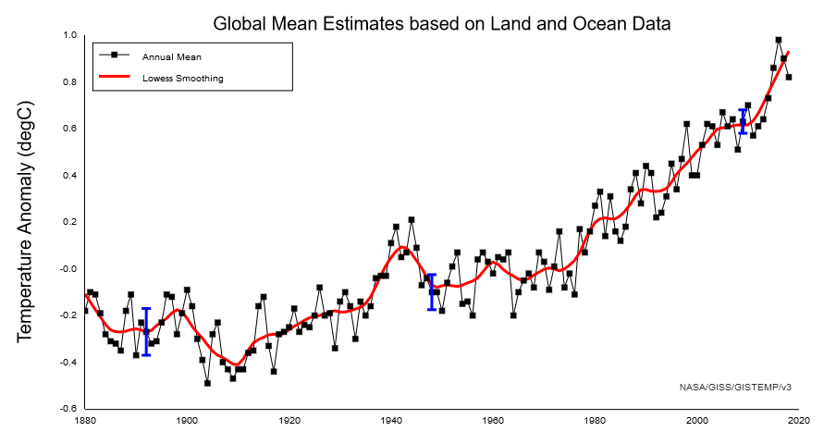
Global assessment of station data: Last below average year was 1976
Rank | year | Anomaly (degC)
1 | 2016 | .98
2 | 2017 | .90
3 | 2015 | .86
4 | 2018 | .82
5 | 2014 | .73
6 | 2010 | .70
7 | 2005 | .67
8 | 2007 | .64
9 | 2013 | .64
10 | 2009 | .63
11 | 1998 | .62
12 | 2002 | .62
13 | 2006 | .62
14 | 2012 | .61
15 | 2003 | .61
16 | 2011 | .57
17 | 2001 | .54
18 | 2004 | .53
19 | 2008 | .52
20 | 1997 | .47
El Chichon
Agung
Pinatubo
Anomaly is measured relative to the average of this period (1951-1980)
Notes:
http://data.giss.nasa.gov/gistemp/graphs/Fig.A2.txt from radiosonde, buoys, satellite
Anomally is difference from 1951-1980 baseline
Pinatubo 4/1991
El Chichon 1983
Agung 1963
Hiatus in 1940-1960
1) 1939-1941 uninsulated bucket (biased cold) was replaced by engine intake (biased warm)
1940’s (WWII) less US ships (used engine intake) were replaced by UK ships (buckets)
(Thompson 2008 and 2010 Nature)
Thompson, D.W.J., J.M. Wallace, J.J. Kennedy and P.D. Jones 2010. An abrupt drop in Northern Hemisphere sea surface temperature around 1970. Nature v.467 p.381-381
Thompson, D.W.J., J.J. Kennedy, J.M. Wallace and P.D. Jones 2008. A large discontinuity in the mid-twentieth century in observed global-mean surface temperature. Nature v.453 p.646-649.
2) N.H. warming slower in the 1950’s due to aerosols from power plants
2000’s Hiatus
tropical Pacific SSTS were lower (natural variability)
these propagate to N.H. in wintertime
Kosaka, Y. and S.P. Xie 2013. Recent global-warming hiatus tied to equatorial Pacific surface cooling. Nature v.502 p.403-407.

Slide 13
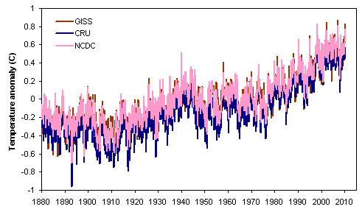
Very likely (95% certain) that temperature is increasing
Weather station records over the last 135 years
3 independent analysis agree
last decade is the warmest on record
Ratio of Maximum:Minimum records are 2:1
Other records substantiate that the recent global warming is unprecedented in last 2000 years.
Satellite measurements since 1979
Tree Rings, warmest in 2000 years
Borehole temperature measurements, 500 years
Glacial length, 169 glaciers, 300 years
Warm pool ocean sediment (δ¹⁸O,Mg/Ca), 2000 years
Arctic sediment, 2000 years
Stalagmite measurements in caves, 500 years
Ocean heat content and sea surface temperature
Ice-core measurements show how this inter-glacial compares to previous inter-glacials
Isotopes in ice sheet cores, 150,000 years (Greenland), 800,000 years (Antarctica) and millions of years (ocean sediment records)
Warmer periods had high CO2 (due to natural processes)
caused higher sea levels
Eemian (125,000 years ago) sea level rise exceed 6-9 meters in ~500 years – if true, implies rapid melt of Antarctic ice at 21st century T’s
Notes:
Inter-comparison: https://www.skepticalscience.com/print.php?r=255
recent T change also seen by climate skeptics
Rohde, R., R.A. Muller, R. Jacobsen, E. Muller, S. Perlmutter, A. Rosenfeld, J. Wurtele, D. Groom and C. Wickham 2012. A new estimate of the average Earth surface land temperature spanning 1753 to 2011. Geoinfor Geostat. v.1 p.1-7.
Tree Rings: Mann, M.E., Z. Zhang, M.K. Hughes, R.S. Bradley, S.K. Miller, S. Rutherford and F. Ni 2008. Proxy-based reconstructions of hemispheric and global surface temperature variations over the past two millennia. Proc. Nat'l Acad. Sci. v.105 p.13252-13257.
2:1 records: Meehl, G.A., C. Tebaldi, G. Walton, D. Easterling and L. McDaniel 2009. Relative increase of record high maximum temperatures compared to record low minimum temperatures in the U.S. Geophys. Res. Lett. v.36 L23701 doi:10.1029/2009GL04073, 5 pgs
Boreholes: Huang, S., H.N. Pollack and P.Y. Shen 2000. Temperature trends over the last five centuries reconstructed from borehole temperatures. Nature v.403 p.756-758
Stalagmites: Smith, C.L., A. Baker, I.J. Fairchild, S. Frisia and A. Borsato 2006. Reconstructing hemispheric-scale climates from multiple stalagmite records. Int. J. Climatology v.26 p.1417-1424.
Glaciers: Oerlemans, J. 2005. Extracting a climate signal from 169 glacier records. Science v.308 p.675-677
Warm pool sediment: Oppo, D.W., Y. Rosenthal and B.K. Linsley 2009. 2,000-year-long temperature and hydrology reconstructions from the Indo-Pacific warm pool. Nature v.460 p.1113-1116.
Sediment cores: Spielhagen, R.F. and et al. 2011. Enhanced modern heat transfer to the Arctic by warm Atlantic water. Science v.331 p.450-453.
Ocean heat content:
Levitus, S., J.I. Antonov, T.P. Boyer, R.A. Locarnini, H.E. Garcia and A.V. Mishonov 2009. Global ocean heat content 1955-2008 in light of recently revealed instrumentation problems. Geophys. Res. Lett. v.36 L07608 doi:10.1029/2008GL037155, 5 pgs.
Levitus, S., J.I. Antonov and T.P. Boyer 2005. Warming of the world ocean, 1955-2003. Geophys. Res. Lett. v.32 L02604 doi:10.1029/2004GL021 592, 5 pgs.
Levitus, S., J.I. Antonov, T.P. Boyer and C. Stephens 2000. Warming in the world ocean. Science v.287 p.2225-2229.
Hansen, J., M. Sato, P. Kharecha and K. von Schuckmann 2011. Earth's energy imbalance and implications. Atmos. Chem. Phys. (Discuss.) preprint, 39 pgs.
Johnson, G.C. and S.E. Wijffels 2011. Ocean density change contributions to sea level rise. Oceanography v.24 p.112-121.
Leuliette, E.W. and J.K. Willis 2011. Balancing the sea level budget. Oceanography v.24 p.122-129.

Slide 14
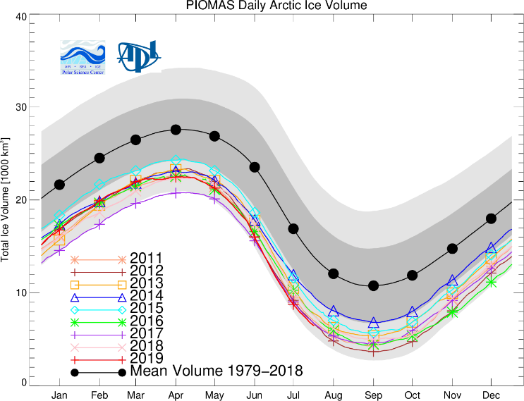
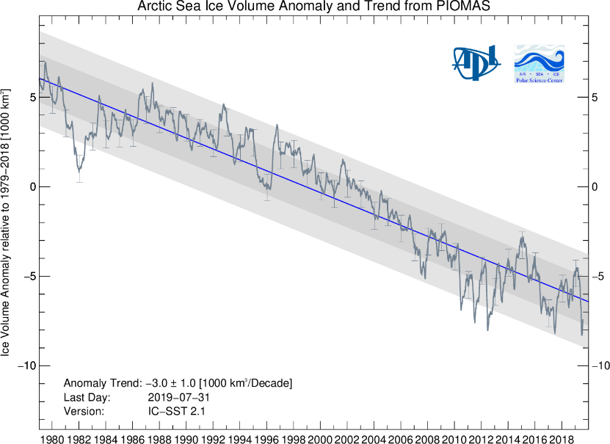
Ice-volume is important from a climate perspective
Ice thickness estimation is more difficult than ice extent.
1976-2016 mean volume is 28,000 km³ in April and 11,500 km³ in Sep.
+/- 750 km³ for monthly averages
April 2018 is 2nd lowest on record
Annual average loss is 280 +/- 100 km³/y (≡ 0.4 W/m²)
Avg{2017} record low, 12,900 km3
Remaining ice is more vulnerable to warming, wind and storms.
1984 30% ≥ 5 year old, now ~2%
1984 60% ≥ 1 year old, now 30%
Arctic ice could be ice-free during summer months by 2030’s.
Notes:
(Kwok 2009 GRL) conclude wintertime ice thickness decreased from ~3.64m in 1980 to ~1.89m in 2008 - 48% over the 1980-2008 = 17.1%/decade
Figures downloaded Aug 28, 2019 from
http://psc.apl.washington.edu/wordpress/research/projects/arctic-sea-ice-volume-anomaly/
May-June 2018 Earth Observer, v.30 pg. 37
1984 30% ≥ 5 year old, now ~2%
1984 60% ≥ 1 year old, now 30%
[PIOMAS 2018 website] PIOMAS Arctic Sea Ice Volume Reanalysis
-------------------------------------------------------------
site downloaded 5/17/2018
- PIOMAS has been extensively validated through comparisons with
US-Navy submarines, oceanographic moorings, and satellites
- uncertainties:
trend is +/- 100 km^3/y
monthly averaged ice volume anomaly is +/- 750 km^3
total volume in Oct. is 1350 km^3
(Schweiger et al. 2011 JGR)
Fig.2: tick marks are 1st day of year
- 2017 annually averaged sea ice volume was lowest on record with
12,900 +/- 1350 km^3
- 2012 was 13,500 +/- 1350 km^3
- trend was 280 +/- 100 km^3/y and is a conservative estimate
- 8.6e19 Joule or 86% of US energy consumption
- US Energy Consumption in 2009 was 1e20 Joule
- spread over entire Arctic is 0.4 W/m^2
(NOTE: 0.6 W/m^2 imbalance (Stephens 2014)
Hansen small x-mas bulb is ~1 W/m^2, GHG warming is like 2 bulbs per m^2
Fig.1: shaded areas are 1 and 2 SDV's of annual mean
- model mean annual cycle of sea ice volume over 1979-2016 ranges
from 28,000 km^3 in April to 11,500 km^3 in September
- 16,400 annual cycle (1979-2010) = 5e21 J = 50x US Energy Consumption
- energy comes from change in solar radiation as Earth orbits
- Average Arctic sea ice volume in April 2018 was 22,250 km^3
- 2nd lowest on record
- thickness anomalies anomalies 2018 relative to 2011-2017 are
positive in the East Siberian Sea and negative in much of the rest
of the Arctic
- anomalous weather can have substantial effects on the large
distribution of sea ice thickness in the Arctic

Slide 15
What is Climate Sensitivity?
Climate sensitivity is the change in Earth’s effective temperature to a doubling of atmospheric CO2
Uncertainty to predict future climate is due to
Inability to predict human emissions
Uncertainty in climate sensitivity.
Better understanding of Earth’s climate sensitivity, with potential reduction in its uncertainty, will require better understanding of a variety of climate feedback processes (Bony et al. 2006).
Need to understand processes.
Need to understand how they interact.

Slide 16
Radiative Forcing by GHG’s
At right is shown the direct radiative forcing due to increasing CO2 or CH4 in the atmosphere (Myhre 1998)
It is non-linear and can be best expressed in terms of doubling of CO2 from pre-industrial (280 ppm) values. (560 ppm and 1120 ppm are shown as red lines in the fig.)
Radiative forcing due to CO2 adds 3.7 W/m² per doubling of CO2.
In equilibrium, this will be balanced by the Planck feedback (σT⁴), and will result in 1.2 C of warming in equilibrium
Doubling of methane from pre-industrial (700 ppb) results in about 0.45 W/m² or about 50 times more forcing per molecule than CO2.
Notes:
Myhre, G., E.J. Highwood, K.P. Shine and F. Stordal 1998. New estimates of radiative forcing due to well mixed greenhouse gases. Geophys. Res. Lett. v.25 p.2715-2718.
3.7 W/280 ppm-CO2 = 0.0132 W/ppm-CO2 0.45W/0.7 ppm-CH4 = 0.643 W/ppm-CH4

Slide 17
Global warming theory
Mlynczak 2016 GRL 10.1002GL068827
Uncertainty in radiative forcing in models is < 1%
This is in response to William Happer, Princeton atomic physicist who wrote a paper saying models overestimated CO2 forcing by factor of 2-3.
William Happer was a candidate for Trump administration science advisor
See: https://www.theguardian.com/environment/planet-oz/2017/feb/21/trumps-potential-science-adviser-william-happer-hanging-around-with-conspiracy-theorists
Climate models simulate decade-scale “hiatus” behavior
Related to ocean-atmosphere interactions in models.
Need to look at all observations (ocean + atmosphere + land)
Smoothing observations shows growth in temperature has been relatively uniform.
Notes:
Risbey, J.S. and S. Lewandowsky 2017. The "pause" unpacked. Nature
v.545 p.37-39.
Medhaug, I., M.B. Stolpe, E.M. Fischer and R. Knutti 2017. Reconciling
controversies about the 'global warming hiatus.'. Nature v.545 p.41-47.
Schurer, A.P., G.C. Hegerl and S.P. Obrochta 2015. Determining the
likelihood of pauses and surges in global warming. Geophys. Res. Lett.
v.42 p.5974-5982. doi:10.1002/2015GL064458

Slide 18
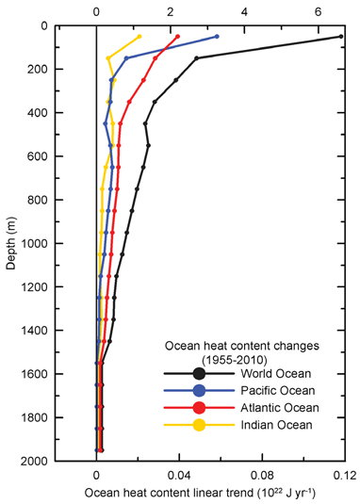
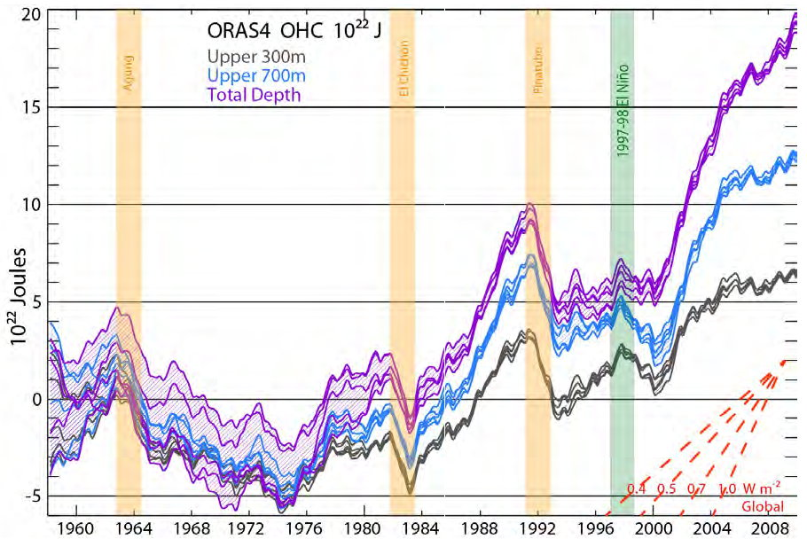
Oceans hold more heat than air and 70% of the world is ocean
Oceans are warming at depth
Recent “hiatus” (lack of increase from 2000-2013) is consistent with ocean-atmosphere heat exchange
Climate models simulate multi-decadal atmospheric warming hiatus due to natural ocean circulation variability
Ocean has been storing a large amount of energy at depth in recent decades.
Notes:
Heating vs time figure: Balmaseda, M.A., K.E. Trenberth and E. Kallen 2013. Distinctive climate signals in reanalysis of global ocean heat content. Geophys. Res. Lett. doi:10.1002/grl.50382(pip), 17 pgs
Heating vs. depth figure: Levitus, S., J.I. Antonov, T.P. Boyer, O.K. Baranova, H.E. Garcia, R.A. Locarnini, A.V. Mishonov, J.R. Reagan, D. Seidov, E.S. Yarosh and M.M. Zweng 2012. World ocean heat content and thermosteric sea level change (0-2000 m), 1955-2010. Geophys. Res. Lett. v.39 L10603 doi:10.1029/2012 GL051106, 5 pgs
Kosaka, Y. and S.P. Xie 2013. Recent global-warming hiatus tied to equatorial Pacific surface cooling. Nature v.502 p.403-407

Slide 19
Fast Feedback Mechanisms in Models
 | Feedback (W/m²)/K | units
Planck | -3.2 | Thermal outgoing radiation due to +1 C
Water Vapor | +1.80 ± 0.18 | 7% change in relative humidity per C
Lapse Rate | -0.84 ± 0.18 | Anti-correlated w/ water vapor
Albedo (surface reflection of sunlight) | +0.26 ± 0.08 | 75% from Northern Hemisphere, loss of ice sheets and snow.
Clouds and aerosols | +0.69 ± 0.38 | Reflect solar (cooling) Trap outgoing radiation (warming)
Carbon Cycle | +0.25 (Knutti 2003) | Respiration from decomposing biomass or reduced uptake (land or ocean) results in more CO2 into atmosphere due to increased temp.
Notes:
Lorius 1990 Nature v.347, p.139
N = (1-a)*S/4 – e*sigma*T^4, S =1370 W/m^2, a=0.3
dTe = Te*dQ/(1-a)/S = 0.3*dQ if dQ=4 W/m^2, dTe=1.2C
Andreae 2005 Nature - CO2 alone is 1.2 C/doubling
Bony 2006 J. Clim v.19, p.3445
NOTE: clouds are net cooling in current time, but this effect diminished as T warms
obs indicate low level cloud opt.depth decreases and SW weakens with T
IPCC 2007, pg. 626
planck 1.2 (Hansen 1984, Bony 2006)
w.v. 1.8 +/- 0.18 W/m^2/C }
lapse -0.84 +/- 0.18 W/m^2/C } anticorrelated combined 1 W/m^2/C
albedo +0.26 +/- 0.08 W/m^2/C (3/4 arises f/ N.H.)
cloud +0.69 +/- 0.38 W/m^2/C (Soden and Held 2006)
Carbon Feedback
Boer 2009 GRL, Arnone 2008 Nature, Matthews 2007 GRL
Knutti, R., T.F. Stocker, F. Joos and G.K. Plattner 2003. Probabilistic climate change projections using neural networks. Climate Dynamics v.21 p.257-272

Slide 20
Climate sensitivity estimates temperature increase due to doubling CO2 (K/2xCO2)
3 ± 1.5 | Charney 1979 | Manabe and Hansen models
3 to 4 | Lorius 1990 | Greenland, Vostok ice cores
1.0 to 9.3 | Andronova 2001 | 1856-1997 T(air) 54% chance it is outside 1.4 to 4.5
2.2 to 9.3 | Knutti 2003 | 1955-1995 T(Ocean) w/ NN
2.0 to 11.0 5% > 8 K | Stainforth, 2005 | Ensemble of HadAM3 models.
2.1 to 8.8 | Forest 2006 | 20th century T(air), SST
1.5 to 6.1 | Hegerl 2006 | 700 yr T reconstruction
1.2 to 4.3 | Von Deimling 2006 | Last Glacial Max.
≥ 1.5, <2.8> | Royer 2007 | Proxy evidence of last 420 My
2.1 to 4.4 1.7 to 4.2 | 4th IPCC, 2007 3rd IPCC, 2001 | 5 and 95% of PDF
7.1 to 9.6 | Pagani 2009 | Piocene T/q measurements
3.3 to 5.5 | Beerling 2011 | Eocene (55 Mya) and Cretaceous (90 Mya) modeling.
Notes:
This table is an updated version of IPCC 4th WG3 see pg. 721,722 Table 9.3
Andronova, N.G., and Schlesinger, M.E. 2001. Objective estimation of the probability density function for climate sensitivity. J. Geophys. Res. v.106, p.22605-22611
Charney, J.G. 1979. Carbon dioxide and climate: a scientific assessment. National Academy Press, Washington DC
Forest, D.J., Stone, P.H. and Sokolov, A.P. 2006. Estimated PDFs of climate system properties including natural and anthropogenic forcings. Geophys. Res. Lett. v.33 L01705, doi:10.1029/2005GL023977.
Hegerl, G.C., T.J. Crowley, W.T. Hyde and D.J. Frame 2006. Climate sensitivity constrained by temperature reconstructions over the past seven centuries. Nature v.440 p.1029-1032
Lorius, C., J. Jouzel, D. Raunaud, J.E. Hansen and H. Le Treut 1990. The ice-core record: climate sensistivity and future greenhouse warming. Nature v.347 p.139-145.
Knutti, R., T.F. Stocker, F. Joos and G.K. Plattner 2003. Probabilistic climate change projections using neural networks. Climate Dynamics v.21 p.257-272.
Royer, D.L., R.A. Berner and J. Park 2007. Climate sensitivity constrained by CO2 concentrations over the past 420 million years. Nature v.446 p.530-532
Stainforth, D.A., T. Aina, C. Christensen, M. Collins, N. Faull, D.J. Frame, J.A. Kettleborough, S. Knight, A. Martin, J.M. Murphy, C. Piani, D. Sexton, L.A. Smith, R.A. Spicer, A.J. Thorpe and M.R. Allen 2005. Uncertainty in predictions of the climate response to rising levels of greenhouse gases. Nature v.433 p.403-406
von Deimling, T.S, A. Ganopolski, H. Held and S. Rahmstorf 2006. How cold was the Last Glacial Maximum? Geophys. Res. Lett. v.33
Beerling, D.J., A. Fox, D.S. Stevenson and P.J. Valdes 2011. Enhanced chemistry-climate feedbacks in past greenhouse worlds. Proc. Nat'l Acad. Sci. v.108 p.9770-9775. doi:10.1073/pnas.1102409108
Pagani, M., Z. Liu, J. LaRiviere and A.C. Ravelo 2009. High Earth-system climate sensitivity determined from Pliocene carbon dioxide concentrations. Nature Geoscience v.3 p.27-30.
….
Matthews 2007 GRL – Carbon cycle widens tail
Torn 2006 GRL 1.6 – 6.0 from 360 ky Vostok
Knutti 2006 3.2K 1.5 to 6.5 f/ seasonal cycles of regional T's
Kohler 2010 2.4K 1.4 to 5.2 95% ci f/ glacial cycles
Knutti, R. and G.C. Hegerl 2008. The equilibrium sensitivity of the Earth's temperature to radiation changes. Nature Geosciences v.1 p.735- 743.
-- their figure 3
Kohler, P., R. Bintanja, H. Fisher, F. Joos, R. Knutti, G. Lohmann and V. Masson-Delmotte 2010. What caused Earth's temperature variations during the last 800,000 years? Data-based evidence on radiative forcing and constraints on climate sensitivity. Quaternary Science Reviews v.29 p.129-145.
add
Knutti, R., G.A. Meehl, M.R. Allen and D.A. Stainforth 2006. Constraining climate sensitivity from the seasonal cycle in surface temperature. J. Climate v.19 p.4224-4233.
Knutti, R., T.F. Stocker, F. Joos and G.K. Plattner 2002. Constraints on radiative forcing and future climate change from observations and climate model ensembles. Nature v.416 p.719-723.
Stott, P.A. and J.A. Kettleborough 2002. Origins and estimates of uncertainty in predictions of twenty-first century temperature rise. Nature v.416 p.723-726.

Slide 21
Why is uncertainty asymmetric?
In short, humans cannot comprehend the exponential
We (models) tend to linearize from present day conditions
This tends to underestimate the change that is occuring.
Terrestrial Feedbacks
Canadian Boreal Forest (Kurz 2008 PNAS)
Negates value of carbon off-sets (Betts 2008 Nature)
Increased tree mortality (van Mantgem 2009 Science)
Heat-waves, loss of soil moisture, drought, fire (Australia 2009?)
Feedbacks due to natural long-term carbon sequestration.
Canadian & Siberian Peat Bogs (Ise 2008 Nature Geoscience)
Indonesian Peat Bogs (drained for rice crops) (van der Werf 2008 PNAS)
Using models with both recent and past datasets to constrain carbon feedback (Cox 2008 Science)
Feedbacks due to Permafrost, Clathrates
Accelerated melting (Lawrence 2008 GRL) or stable (Froese 2008 Science, Khvorostyanov 2008 Tellus-B)
New freeze mechanism to release methane (Mastepanov 2008 Nature)
Notes:
Kurz, W.A., G. Stinsom, G.J. Rampley, C.C. Dymond and E.T. Neilson 2008. Risk of natural disturbances makes future contribution of Canada's forests to the global carbon cycle highly uncertain. Proc. Nat'l Acad. Sci. v.105 p.1551-1555.
2007 Pearce Speed and Violence Ch.12 – Borneo Peat Fires 880 tons/acre
van der Werf, G.R., J. Dempewolf, S.N. Trigg, J.T. Randerson, P.S. Kasibhatla, L. Giglio, D. Murdiyarso, W. Peters, D.C. Morton, G.J. Collatz, A.J. Dolman and DeFries R.S. 2008. Climate regulation of fire emissions and deforestation in equatorial Asia. Proc. Nat'l Acad. Sci. v.105 p.20350-20355. doi:10.1073/pnas.0803375105
Betts, R.A. 2008. Offset of the potential carbon sink from boreal forestation by decreases in surface albedo. Nature v.408 p.187-190.
van Mantgem, P.J., N.L. Stephenson, J.C. Byrne, L.D. Daniels, J.F. Franklin, P.Z. Fule, M.E. Harmon, A.J. Larson, J.M. Smith, A.H. Taylor and T.T. Veblen 2009. Widespread increase of tree mortality rates in the western United States. Science v.323 p.521-524
Page, S.E., F. Siegert, J.O. Rieley, H.-D. V. Boehm, A. Jayak and S. Limink 2002. The amount of carbon released from peat and forest fires in Indonesia during 1997. Nature v.420 p.61-66.
Cox, P. and C. Jones 2008. Illuminating the modern dance of climate and CO2. Science v.321 p.1642-1644.
Froese, D.G., J.A. Westgate, A.V. Reyes, R.J. Enkin and S.J. Preece 2008. Ancient permafrost and a future, warmer Arctic. Science v.321 p.1648-1648.
Khvorostyanov, D.V., P. Ciais, G. Krinner, S.A. Zimov, Ch. Corradi and G. Guggenberger 2008. Vulnerability of permafrost carbon to global warming.
warming. Tellus-B v.60 p.250-264 and p.265-275.

Slide 22
Things missing from climate models
Models don't spin up properly (Gregory 2013 GRL)
All models relax to their own background preferred climate (Tollefson 2013 Nat)
LUC is often missing (Christidis 2013 GRL)
Models don't characterize runoff (Fasullo 2013 GRL)
- teleconnection anomalies are inaccurate - LGM dust feedback may be wrong (Lamy 2014 Science)
Links between rainfall and the semi-arid land CO2 sink are missing (Poulter 2014 Nature)
Solar absorption by H2O is underestimated due to lack of weak lines in RTA (DeAngelis 2015 Nature)
Propagation of waves by large storms into sea-ice (Kohout 2014 Nature)
Earth system models for IPCC/AR5 did not include permafrost carbon emissions (Schuur 2015 Nature) - abrupt thaw is not included in large-scale models - offset by vegetation growth not included either
Current cloud/convective parameterizations used in global climate models typically do not account for convective organization (Muller 2012 J.Clim)
Impact of rapid freshwater input to ocean (Hansen 2015 ACPD) causing severe storms, rapid SLR
Models either have an AMOC that is too stable with respect to buoyancy forcing or are missing an important forcing. Greenland meltwater runoff is not included as a forcing in CMIP5 (Rahmstorf 2014 Nat.CC)
(Pollard 2015 EPSL) hydrofracturing (surface water, moulins) and large ice-cliff failure is not included in models
-- greatly accelerated collapse in WAIS
Missing representation of Atmospheric Rivers for Antarctica surface mass balance (Gorodetskaya 2014 GRL)
Mycorrhizal symbioses are not accounted for in most global vegetation models (Terrer 2016 Science), C-only models likely overestimated CO2 fertilization for 65% of globe, N-limitation models likely underestimate CO2 fertliization for mid-latitude trees (~35 % of vegetated area)
C-concentration feedback may be weaker than currently expected from ESMs +170 +/- 127 Pg-C by 2100 (He 2016 Science), life feedbacks (wildfires, agriculture) are not included (Bonan 2018 Science)
"zero curtain is not represented", underestimate permafrost emissions (Commane 2017 PNAS)
Models do not account for long term reversals in CO2 fertilization (Reich 2018 Science)

Slide 23
Climate models have large uncertainty in climate sensitivity
Bony et al. 2006 quantified the range of uncertainty in thr feedbacks used in modern models
WV = Water Vapor C = Cloud
A = Albedo LR = Lapse Rate
Notes:
Bony, S., R. Colman, V.M. Kattsov, R.P. Allan, C.S. Bretherton, J.-L. Dufresne, A. Hall, S. Hallegatte, M.M. Holland, W. Ingram, D.A. Randall,
B.J. Soden, G. Tselioudis and M.J. Webb 2006. How well do we understand and evaluate climate change feedback processes? J. Climate
v.19 p.3445-3482.

Slide 24
Why is uncertainty in climate sensitivity asymmetric?
Complex interactions large feedbacks.
Uncertainty in feedbacks might be Gaussian
Long tail of small, but finite probabilities
Notes:
Climate sensitivity PDF’s is from page 720 of IPCC AR4 Gaussian to long tail figure is from Roe 2007 Science
Torn, M.S. and J. Harte 2006. Missing feedbacks, asymmetric uncertainties, and the underestimation of future warming. Geophys. Res. Lett. v.33 L10703 doi:10.1029/2005GL025540, 5 pgs.
Roe, G.H. and M.B. Baker 2009. Why is climate sensitivity so unpredictable? Science v.318 p.629-632.
Hannart, A., J.L. Dufresne and P. Naveau 2009. Why climate sensitivity may not be so unpredictable. Geophys. Res. Lett. v.36 L16707 doi:10.1029/2009GL039640, 5 pgs.

Slide 25
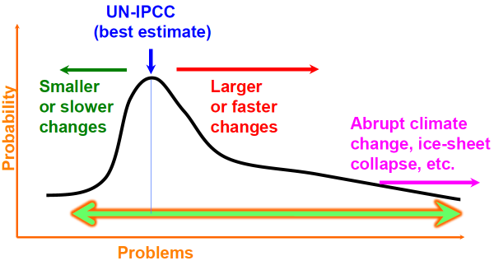
Asymmetric Climate Risk
Science is the best estimate we have, but it is flawed
Non-linear effects are difficult to model (humans tend to linearly extrapolate from our relatively stable climate and do not consider interactions between ocean, atmosphere, biosphere, etc.)
IPCC only considers “mature” science
Graphic from a talk by Richard B. Alley, May 23, 2017
Conservative estimates of
Sea level rise
Biological responses

Slide 26
What if we stopped all (GHG, aerosol, etc.) emissions today?
CO2 has a long effective lifetime in the atmosphere and continues to warm the atmosphere for centuries.
In 2005 the atmosphere had 379 ppm of CO2
Observed increase of 0.8 C in global temperature is a small fraction of the expected equilibrium temperature.
Emissions from 1750 to 2005 will have a committed warming of 2.4 C (1.4 to 4.3 C)
Part of this impact is the cooling provided by aerosols
Each year we delay is curbing emissions adds 9 ppm to the stabilization point for CO2
Equilibrium global temperature assuming all fossil fuel emissions and associated aerosols stop in 2005. Assumed range of climate sensitivity was 2 to 4.5 C/2xCO2
Notes:
Ramanathan, V. and Y. Feng 2008. On avoiding dangerous anthropogenic interference with the climate system: Formidable challenges ahead. Proc. Nat'l Acad. Sci. v.105 p.14245-14250
Mignone, B.K. 2008 Clima Change - 1-year delay == 9 ppmv in stabilization level

Slide 27
Or what if we built no new fossil fuel plants and let existing plants “age-out”
NOTE: This study did not reduce aerosols (as in last page)
Between 2010-2060 496 Gt-CO₂ would be added
In 2060 increase (above pre-industrial) would be 1.3º C (range of 1.1 to 1.4)
Coal plants built within last 10 years are dominant emission (e.g., from China)
By comparison, IPCC scenarios project 3000 to 7400 Gt-CO2 will be added.
Primary threats posed by climate change are from devices that do not yet exist
Notes:
Davis, S.J., K. Caldeira and H.D. Matthews 2010. Future CO2 emissions and climate change from existing energy infrastructure. Science v.329 p.1330-1333.

Slide 28
Assessing Climate Risk
Cox 2018 Nature: Select models based on variance of global T. Climate sensitivity is most likely less than 4 degC/2xCO2 – a good thing
Tian 2015 GRL - model bias seems to correlated with model’s failure to characterize clouds in the ITCZ
Models that characterize the ITCZ better have higher climate sensitivity (~4 degC)
Might indicate where model improvements are needed
Martinez-Boti 2015 Nature – Pliocene (2.6-5.3 Mya) had more CO2 (350-450 ppm), higher sea level (+12-32 meters), and higher temperatures (~3 degC warmer)
Climate sensitivity of ~3.0 to 4.4 degC/2xCO2
Similar sensitivity as late Pleistocene (last 0.8 My) where ice-albedo feedbacks were stronger.
Good news – there are not any strong feedbacks in the warmer climate
Notes:
Cox, P.M., C. Huntingford and M.S. Williamson 2018. Emergent constraint on equilibrium climate sensitivity from global temperature variability. Nature v.553 p.319-324.
Tian, B. 2015. Spread of model climate sensitivity linked to double-Intertropical Convergence Zone bias. Geophys. Res. Lett. v.42 p.4133- 4141.
Martinez-Boti, M.A., G.L. Foster, T.B. Chalk, E.J. Rohling, P.F. Sexton, D.J. Lunt, R.D. Pancost, M.P.S. Badger and D.N. Schmidt 2015. Plio-Pleistocene climate sensitivity evaluated using high-resolution CO2 records. Nature v.518 p.49-54.

Slide 29
350 is the new 450 for low risk (Hansen 2008 Open Atmos. Sci. J)
Climate sensitivity is extremely uncertain with asymmetric with “long-tail” of possible responses of the Earth.
High values representing worlds for which we have no experience.
Paleo-climate data indicates that Earth system can respond much more quickly than previously assumed, +10 C in 60 years.
Rapid events can be used to test sensitivity of models.
Study of Miocene climate shows CO₂ induced temperature changes
Used stomatal index to derive CO₂ 25 million years ago.
D = deuterium excess (proxy for SST)
d18O = amount of ¹⁸O (proxy for evaporation T)
λ = annual thickness (cm)
Notes:
Hansen, J., M. Sato, P. Kharecha, D. Beerling, R. Berner, V. Masson-Delmotte, M. Pagani, M. Raymo, D.L. Royer and J.C. Zachos 2008. Target Atmospheric CO2: Where Should Humanity Aim? Open Atmos. Sci. J. (2008), vol. 2, pp. 217-231
Kurschner, W.M., Z. Kvacek and D.L. Dilcher 2008. The impact of Miocene atmospheric carbon dioxide fluctuations on climate and the evolution of terrestrial ecosystems. Proc. Nat'l Acad. Sci. v.105 p.449-453.
Steffensen, J.P., K.K. Andersen, M. Bigler, H.B. Clausen, D. Dahl-Jensen, H. Fischer, K. Goto-Azuma, M. Hansson, S.J. Johnsen, J. Jouzel, V. Masson-Delmotte, T. Popp, S.O. Rasmussen, R. Rothlisberger, U. Ruth, B. Stauffer, M.L. Siggaard-Andersen, A.E. Sveinbjornsdottir, A. Svensson and J.W.C. White 2008. High-resolution Greenland ice core data show abrupt climate change happens in few years. Science v.321 p.680-684.
The most abrupt transitions are those of the deuterium excess d = dD – 8d18O, a second order isotopic parameter that contains information on fractionation effects caused by the evaporation of source water. The excess is considered to be mainly a proxy of past ocean surface temperatures at the moisture-source region

Slide 30
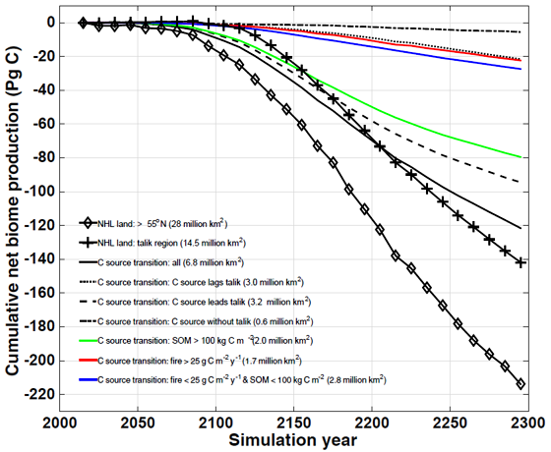
A Huge Climate Wildcard: Permafrost & Clathrates
Inconclusive observations about methane clathrate emissions from the East Siberian Arctic Shelf (Shakhova 2015 Thorton 2016, Myhre 2016)
Good news, current thinking is these are small
Modeling indicates significant future emissions
Uncertainties in carbon stocks, soil decomposition processes are large and concerning
Commane 2017 CO2 sources increasing in Alaska due to increased winter soil respiration.
Parazoo 2018 – “220 Pg-C by 2300 with no signs of slowing”
Von Deiming 2016 RCP8.5 228 Pg-C (CO2), 5.9 Pg-C (CH4), dT = 0.16 degC
Notes:
Andreassen, K. and et al. 2017. Massive blow-out craters formed by hydrate-controlled methane expulsion from the Arctic seafloor. Science v.356 p.948-953.
Commane, R., J. Lindaas, J. Benmergui, K.A. Luus, R.Y.W. Chang, B.C. Daube, E.S. Euskirchen, J.M. Henderson, A. Karion, J.B. Miller, S.M. Miller, N.C. Parazoo, J.T. Randerson, C. Sweeney, P. Tans, K. Thoning, S. Veraverbeke, C.E. Miller and S.C. Wofsy 2017. Carbon dioxide sources from Alaska driven by increasing early winter respiration from Arctic tundra. Proc. Nat'l Acad. Sci. v.114 p.5361-5366.
Lindgren, A., G. Hugelius, P. Kuhry, T.R. Christensen and J. Vandenberghe 2016. GIS-based maps and area estimates of Northern Hemisphere permafrost extent during the Last Glacial Maximum. Permafrost and Periglacial Processes v.27 p.6-16. doi:10.1002/ppp.1851
Myhre, C.L. and et al. 2016. Extensive release of methane from Arctic seabed west of Svalbard during summer 2014 does not influence the atmosphere. Geophys. Res. Lett. v.43 p.4624-4631. doi:10.1002/2016GL068999
Parazoo, N.C., C.D. Koven, D.M. Lawrence, V. Romanovsky and C.E. Miller 2018. Detecting the permafrost carbon feedback: talik formation and increased cold-season respiration as precursors to sink-to-source transitions. The Cryosphere v.12 p.123-144.
Paytan, A., A.L. Lecher, N. Dimova, K.J. Sparrow, F.G.T. Kodovska, J. Murray, S. Tulaczyk and J.D. Kessler 2015. Methane transport from the active layer to lakes in the Arctic using Toolik Lake, Alaska, as a case study. Proc. Nat'l Acad. Sci. v.112 p.3636-3640. doi:10.1073/pnas.1417392112
Petrenko, V.V., et al. and J.P. Severinghaus 2017. Minimal geological methane emissions during the Younger Dryas-Preboreal abrupt warming event. Nature v.548 p.443-446.
Roopnarine, P.D. and K.D. Angielczyk 2015. Community stability and selective extinction during the Permian-Triassic mass extinction. Science v.350 p.38-39.
Schneider von Deimling, T., G. Grosse, J. Strauss, L. Schirrmeister, A. Morgenstern, S. Schaphoff, M. Meinshausen and J. Boike 2015. Observation-based modelling of permafrost carbon fluxes with accounting for deep carbon deposits and thermokarst activity. Biogeosciences v.12 p.3469-3488. doi:10.5194/bg-12-3469-2015
Schuur, E.A.G., A.D. McGuire, C. Schadel, G. Grosse, J.W. Harden, D.J. Hayes, G. Hugelius, C.D. Koven, P. Kuhry, D.M. Lawrence, S.M. Natali, D. Olefeldt, V.E. Romanovsky, K. Schaefer, M.R. Turetsky, CC. Treat and J.E. Vonk 2015. Climate change and the permafrost carbon feedback. Nature v.520 p.171-179.
Shakhova, N. and et al. 2015. The East Siberian Arctic Shelf: Towards further assessment of permafrost-related methane fluxes and role of sea ice. Phil. Trans. R. Soc. Lond. A v.373 doi:10.1098/rsta.2014.0451, 13 pgs.
Stordal, F., H.H. Svensen, I. Aarnes and M. Roscher 2016. Global temperature response to century-scale degassing from the Siberian Traps Large igneous province. Palaeogeogr. Palaeoclimatol. Palaeoecol. v.471 p.96-107.
Thornton, B.F. and et al. 2016. Methane fluxes from the sea to the atmosphere across the Siberian shelf seas. Geophys. Res. Lett. v.43 p.5869-5877. doi:10.1002/2016GL068977

Slide 31
Technical Solutions
Stop burning fossil fuels
Efficiency improvements
Biofuels (emissions ≤ fossil-equivalent)
Non-carbon energy (solar, wind, nuclear, tidal, etc.)
Adaptation
Fortify the coastlines.
Resiliency, prepare for flooding and/or drought.
Allow pathways for bio-migration.
Mitigation
Cool the Earth by reflecting more sunlight.
Remove the CO2 from the atmosphere.
Land and Oceans will de-gas, ultimately need to remove that carbon
1081 Gt-C stored in 2050: 494 atmosphere, 304 land, and 283 oceans
Notes:
Cao, L. and K. Caldeira 2010. Atmospheric carbon dioxide removal: long-term consequences and commitment. Environ. Res. Lett. v.5 doi:10.1088/1748-9326/5/2/024011, 6 pgs.
Total Antropogenic C is 1081 Gt-C in 2049
45.7% atmospheric CO2: 494 Gt-C = (511-278 ppm)*0.212 Gt-C/ppm
26.2% ocean CO2 = 283 Gt-C
28.1% land CO2 = 304 Gt-C

Slide 32
Energy efficient buildings
Buildings account for 43% of US GHG emissions.
76% of all US electricity is used to operate commercial and residential buildings
By 2035, 75% of buildings will be new or renovated.
Investment of $22 billion over next 12 years could save 11.1 Quad-BTU,
Off the shelf methods cloud be employed to reduce emissions by ≈50% now.
Building shape and orientation
Natural heating and cooling
Daylighting and ventilation strategies
Proper shading and energy efficiency measures.
Each Quad-BTU of energy saved is equivalent to that produced from 22 coal plants (500 MW each, cost ~$2B each) or about 0.1 Gt-C/y emissions
Notes:
Figure from Farese, P. 2012. How to build a low-energy future. Nature v.488 p.275-277.
Source (Architecture 2030 4/7/2008 “The 2030 Blueprint”
5 billion sq.ft. of new buildings each yr, 5 billion sq.ft of renovation each year
1.75 billion sq.ft demolished
[Architecture 2030 4/7/08] The 2030 blueprint
---------------------------------------------
81% of CO2 emissions from electric power sector
76% of all electricity generated is used to operate buildings (EIA)
38.5 QBTU of primary energy consumed by residential and commercial in USA
27.3 QBTU in electricity, of this, 14.2 QBTU (52%) by coal-fired power
off the shelf efficiency measured could reduce 11.1 QBTU with an investiment of $21.6 billion/QBTU (over 12 year period)
building shape and orientation
- natural heating and cooling
- daylighting and ventilation strategies
- proper shadings and - off the shelf energy efficiency measures
1 QBTU = 22.3 conventional coal fired-plants (0.71 QBTU) + 204 billion cu.ft. of nat'l gas and 10.7 million bbl's of oil (0.29 QBTU)
==) reduce CO2 emissions by 86.7 million metric tons ==) save consumers $8.46 billion in energy bills/year (3 year payback) ==) create 216,000 new jobs
==) money saved and jobs cycle through economy many times
1 QBTU = 1.055E15 J = 1055/3600 TWh = 293 TWh = 172 million bbl(oil) = 36 million ton(coal)
- Investing $21.6 billion will buy you
cost to build conventional 1GW coal plant is 2.6 billion
cost to build 1 GW nuclear is $6 billion and takes 8-12 years cost to build
coal plants with CCS is $256 billion/QBTU and 20 years out
cost to incorporate energy efficiency measures is $21.6 * 1.95
(multiplied for energy losses)
building coal(CCS) nuclear
conventional 500 MW coal plants -22.3 -6.6 -7.2
coal plants CO2 emissions -86.7 -21.1 -23.0 MMT
consumer savings $8.46 billion zero zero
job creation 216,000 zero zero
cost/QBTU $41.1 $256 $222 billion
timeframe now 20 y 8-12 years

Slide 33
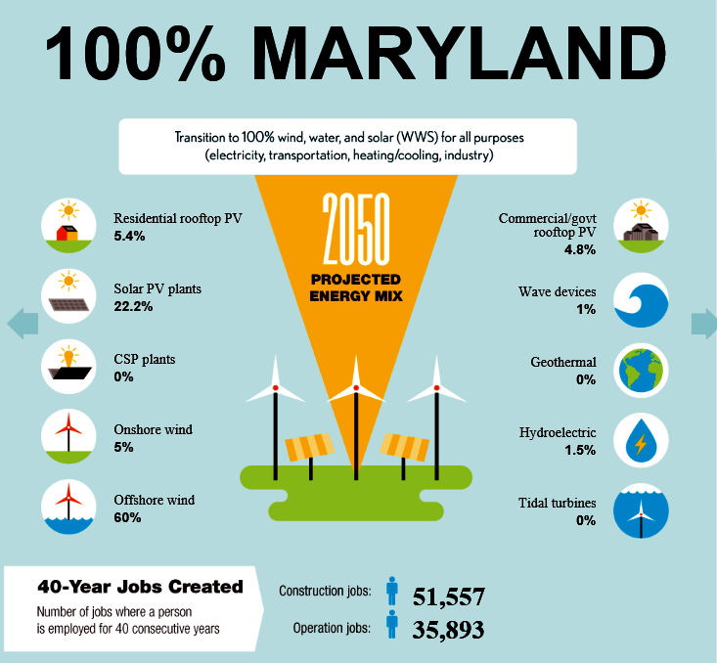
USA could be 100% renewable by 2050
Mark Jacobson has created a 50 state energy roadmap
Jacobson 2015 Energy &
Environmental Science v.8 p.2093-2117
See: http://thesolutionsproject.org/infographic
Click on state
e.g., part of Maryland page is to the right
Notes:
Jacobson, M.Z., M.A. Delucchi, G. Bazouin, Z.A.F. Bauer, C.C. Heavey, E. Fisher, S.B. Morris, D.J.Y. Piekutowski, T.A. Vencill, T.W. Yeskoo and et al. 2015. 100% clean and renewable wind, water, and sunlight (WWS) all-sector energy roadmaps for the 50 United States. Energy & Environmental Science v.8 p.2093-2117. doi:10.1039/c5ee01283j

Slide 34
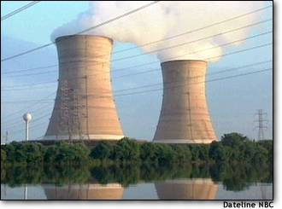
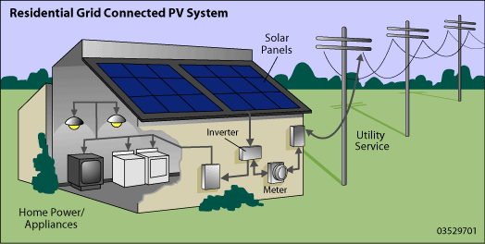
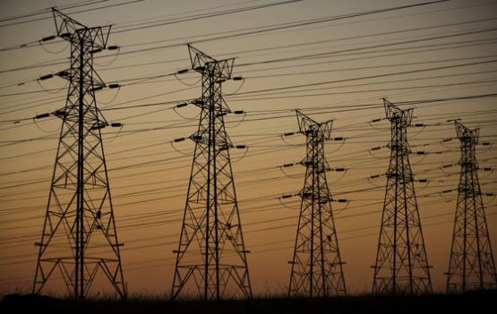
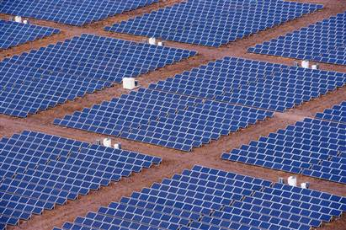
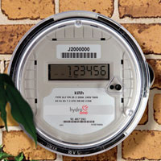
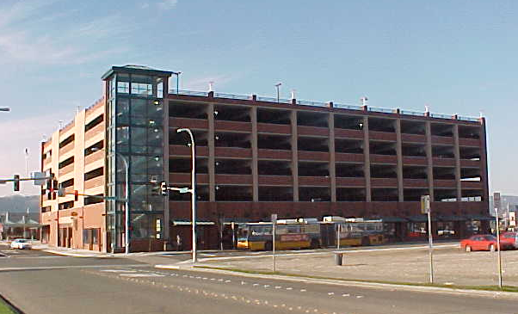
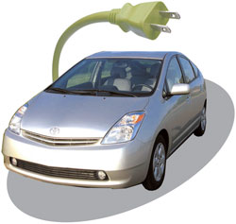
The “Ener-net” is an idea that could exploit energy portfolio
Nuclear plants shut down in heat waves & cannot cycle rapidly
Coal plants have 12% shutdowns & cannot cycle rapidly
Wind peaks at night, solar peaks when demand is high.
Excess solar and wind can be used to make liquid fuels
Hydro-power, natural gas power plants, smart cars, and home appliances can smooth out intermittent signals
from wind and solar
Nuclear
Hydro
Wind
Solar
100’s of cars could sell & buy power from grid
Notes:
Idea is from Friedman, 2008 Hot Flat and Crowded
Also used:
Jacobson 2008 Energy & Envir. Science
Marris, E. 2008. Upgrading the grid. Nature v.453 p.570-573.

Slide 35
Comparison of geo-engineering approaches
 | Reflect sunlight “Climate Intervention” | Remove CO2 “Carbon Remediation”
Timescale of response | Rapid (years) | Slow (decades)
Cost | $10’s billion/year | $100’s billion/year
Advantages | Low cost. Can respond to “climate emergencies” | Solves the real problem. Many ideas can be employed
Disadvantages | Only lowers T, does not solve ocean acidification, polar warming, etc. | Need long-term commitment because ocean and terrestrial uptake will slow down.
Risks | Different geographic response. Potential “winners” and “losers” | Leakage of CO2 from some storage mechanisms
Both methods will probably encourage higher emissions and might delay society from switching to renewable sources of energy.
Notes:
CCS storage in basalts are form of geologic conversion
Gislason, S.R. and E.H. Oelkers 2014. Carbon storage in basalt. Science v.344 p.373-374.
Gislason, S.R. and et al. 2010. Mineral sequestration of carbon dioxide in basalt: A pre-injection overview of the CarbFix project. Int. J. Greenhouse Gas Control v.4 p.537-545.
Replace sand on beaches with ground up olivine:
Hangx, S.J.T. and C.J. Spiers 2009. Coastal spreading of olivine to control atmospheric CO2 concentrations: A critical analysis of viability. Int. J. Greenhouse Gas Control v.3 p.757-767.
Kohler, P., J.F. Abrams, C. Volker, J. Hauck and D.A. Wolf-Gladrow 2013. Geoengineering impact of open ocean dissolution of olivine on atmospheric CO2, surface ocean pH and marine biology. Environ. Res. Lett. v.8 doi:10.1088/1748-9326/8/1/014009, 9 pgs.
Kohler, P., J. Hartmann and D.A. Wolf-Gladrow 2010. Geoengineering potential of artificially enhanced silicate weathering of olivine. Proc. Nat'l Acad. Sci. v.107 p.20228-20233.

Slide 36
Example of a Simple Mitigation: Bury the carbon
Forests produce 10 Gt-C/yr in woody debris
42% in tropical forests
37% in temperature forests
21% in boreal forests
Old trees have less carbon uptake and could be cut, buried, and replaced by young trees.
500 t-C can be sequestered in 10x10x20 meter covered by 5 meters of soil.
10 Gt-C/yr at cost of $50/t-C
1% ($0.5 trillion) of GDP ($48 trillion in 2006)
Would employ 4 million workers worldwide.
But … need 1 trench every 1.5 seconds
Low technology
Low risk
Mitigates wildfire emission risk.
Notes:
Zeng, N. 2009. Carbon sequestration via wood burial. Carbon Balance and Management v.3 doi:10.1186/1750-0680-3-1
World GDP was $48 trillion in 2006 10 Gt-C/yr * $50/t-C = $0.5 trillion/yr = 1% of GDP

Slide 37
Can we increase the rate of natural weathering?
Natural carbonation of peridotite by weathering is common
Natural rate is slow, 40,000 t-CO₂/yr
Need to increase by factor of 100,000 to absorb annual emissions
We have added ≈ 800 Gt-CO₂ since pre-industrial times.
Drilling and hydraulic fracturing would expose more peridotite for weathering
Could increase weathering by factor of 1 million (2 Gt-CO₂/km³)
Carbonation increases rock volume by 44% and produces heat that will fracture rock
Reaction can become self sustaining if high concentration CO₂ in injected
 | Volume (km^3) | Gt-CO2
Baltimore mafic complex (PA,MD,DC) | 6 | 6.5
Monte del Estado, Puerto Rico | 135 | 135
Oman (pictured above) | 70,000 | 1400
Papau New Guinea | 50,000 | 1000
Adriatic Sea | Several 20,000 | 1000
Notes:
Picture from Kelemen, P.B. and J. Matter 2008. In situ carbonation of peridotite for CO2 storage. Proc. Nat'l Acad. Sci. v.105 p.17295-17300.
Mg2SiO4 + 2CO2 = 2MgCO3 + SiO2
Mg-olivine + 2CO2 = magnesite + quartz
Peridotite is composed of olivine ((Mg,Fe)₂SiO₄) and Pyroxene ((Ca,Mg,Fe)₂Si₂O₆) which react with water and CO₂ to form hydrous silicates (serpentine), iron-oxides (magnetite), and carbonates (calcite, magnesite, dolomite)
Goff, F. and et al. 2000. Evaluation of ultramafic deposits in eastern United States and Puerto Rico as sources of magnesium for carbon dioxide sequestration. Los Alamos Tech. Report LA-13694-MS, 36 pgs.
Table is a combination of both references.
Kelemen showed that enhanced weathering can achieve 2 Gt-CO2/km^3
O'Connor, W.K., D.C. Dahlin, D.N. Nilsen, G.E. Rush, R.P. Walters and P.C. Turner 2001. Carbon dioxide sequestration by direct mineral carbonation: results from recent studies and current status. DOE/NETL 1st Annual Conf. Carbon Seq., 10 pgs.

Slide 38
There are many mitigation ideas: Some pro’s and con’s
Mitigation method | Pro’s and Con’s) | Cost or benefits
Accelerated weathering | Very low risk (+), does what nature will ultimately do (++) | Makes limestone
Carbon Capture and Storage (CCS) | Risk of leakage until it is absorbed by rock (-) | $75 /t-CO2 (Orr 2009)
Liquid CO2 in ocean | Risk of leakage (--)
Ocean dissolution of Olivine | Very low risk (+), Trace elements (-) Reduces ocean pH (+) | $40/t-CO2 (Kohler 2013, Rau 2011)
Amine scrubbing/NaOH | Leakage of CCS (-) | $100-180/t-CO2 (Socolow 2011)
Ocean Fe fertilization | Changes to food web (--)
Tree farms w/ burial | Low tech (+) N-limit (?), 1000y time-scale (-) | $25-100/t-CO2 (Zeng 2009)
Biochar & soil storage | 1000 y timescale (-) | Improves agriculture yield
Algae to biofuel | C neutral | $150/t-CO2
Use CO2 for industrial applications | C neutral, max capacity is ~10% | Mostly cost neutral
Notes:
reactions:
quick lime: CaO + CO2 → CaCO3
Amine: NaOH + CO2 → NaCO3 + H
NaCO3 + CO2 → NaCO3 + H
NaCO3 + Ca(OH)_2 → CaCO3 + NaOH
Olivine: Mg2SiO4 + 4CO2 + 2H2O → 2Mg++ + 4HCO3- + SiO4
Soil and biochar
Comparison of methods, see: Smith, P., S.J. Davis and C. Yongsung 2016. Biophysical and economic limits to negative CO2 emissions. Nature Climate Change v.6 p.42-50. doi:10.1038/nclimate2870
Comparison of climate-smart soils: Paustian, K., J. Lehmann, S. Ogle, D. Reay, G.P. Robertson and P. Smith 2016. Climate-smart soils. Nature v.532 p.49-57.
Basalt storage (CCS w/ weathering):
White, J.A. and et al. 2014. Geomechanical behavior of the reservoir and caprock system at the In Salah CO2 storage project. Proc. Nat'l Acad. Sci. v.111 p.8747-8752. doi:10.1073/pnas.1316465111
Matter, J.M., et al. and W.S. Broecker 2016. Rapid carbon mineralization for permanent disposal of anthropogenic carbon dioxide emissions. Science v.352 p.1312-1314.
Tollefson, J. 2013. A line in the sands. Science v.500 p.136-137.
Gislason, S.R. and E.H. Oelkers 2014. Carbon storage in basalt. Science v.344 p.373-374.
Gislason, S.R. and et al. 2010. Mineral sequestration of carbon dioxide in basalt: A pre-injection overview of the CarbFix project. Int. J. Greenhouse Gas Control v.4 p.537-545.
Werner, M. and et al. 2014. A physical model for geological CO2 storage - Replacing misconceptions by visual explanation. Int. J. Greenhouse Gas Control v.25 p.42-53.
olivine:
Taylor, L.L., J. Quirk, R.M.S. Thorley, P.A. Kharecha, J. Hansen, A. Ridgwell, M.R. Lomas, S.A. Banwart and D.J. Beerling 2015. Enhanced weathering strategies for stabilizing climate and averting ocean acidification. Nature Climate Change doi:10.1038/nclimate2882, 7 pgs.
Hangx, S.J.T. and C.J. Spiers 2009. Coastal spreading of olivine to control atmospheric CO2 concentrations: A critical analysis of viability. Int. J. Greenhouse Gas Control v.3 p.757-767.
Kohler, P., J.F. Abrams, C. Volker, J. Hauck and D.A. Wolf-Gladrow 2013. Geoengineering impact of open ocean dissolution of olivine on atmospheric CO2, surface ocean pH and marine biology. Environ. Res. Lett. v.8 doi:10.1088/1748-9326/8/1/014009, 9 pgs.
Kohler, P., J. Hartmann and D.A. Wolf-Gladrow 2010. Geoengineering potential of artificially enhanced silicate weathering of olivine. Proc. Nat'l Acad. Sci. v.107 p.20228-20233.
Industrial
Cressey 2014 Nature Firms that suck carbon from air go commercial. V.525 p.306-307

Slide 39
It all comes down to economics
We have the technology to solve the problem
It will cost ~50-100 $/t-C to remove CO2 from air
$1.5 to $3 Trillion to remove 1 year’s worth of emissions
It won’t “produce” anything consumers want
But, it will leave the Earth the way we found it
And reduce risk for future generations
The most difficult: we must leave 10’s of trillions of $$’s in the ground, unexploited
820 billion tons of Coal ($50 T) : (USA, Russia, China)
420 billion barrels of Oil ($40T): (Middle East, America’s)
95 trillion m³ of Nat’l gas ($20T): (Middle East, Russia)
Notes:
30 Gt-CO2/y * $50 = 1500e9 = 1.5 trillion $
Jakob, M. and J. Hilaire 2014. Unburnable fossil-fuel reserves. Nature v.517 p.150-151
- fossil-fuel reserves, which are currently worth about US$27 trillion
- reserves: 1,294 billion barrels of oil, 192e12 m^3 gas, 728 Gt of hard coal, and 276 Gt of lignite
McGlade, C. and P. Ekins 2014. The geographical distribution of fossil fuels unused when limiting global warming to 2 degC. Nature v.517 p.187-190
OSA = Other Developing Asian, 1bbl = 0.159 m^3
over 430 Bbbls of oil, 819 Gt-coal, and 95 trillion m^3 of gas should remained unburned
100 B bbls of oil and 35 T m^3 of gas within the Arctic Circle should not be produced
At $10/M-BTU*M-BTU/T-m^3
430e9 bbls of oil at $100/bbl will leave 43 Trillion $$
Nat’l gas at $200/1000 m^3 * 95e9 1000 m^3 = $19e12
Coal at $2/GJ and 30 GJ/t-coal, a tonne of coal is worth ~$60/t-coal (current price is ~48/t-coal)
819e9 t-coal = 49 Trillion $$

Slide 40
What is the value of ecosystem services? $33 Trillion per year
Ignore non-renewable items (oil, gas, coal, etc.)
Consider 17 major categories
Gas (CO2/O2, UV-B, SOx), climate, water, and disturbance regulation.
Water supply, erosion control, soil formation
Nutrient recycling, waste treatment
Pollination, Food production, Raw materials (lumber etc)
Then, consider the cost if technology had to replicate what nature does
Region | Area (10⁶ ha) | Value ($/ha/yr) | Value (billion $/yr)
Marine (total) | 36,302 | 577 | 20,949
_Coastal | 3,102 | 4,052 | 12,568
__ Estuaties | 180 | 22,832 | 4,110
__ Coral | 62 | 6,075 | 375
Terrestrial (total) | 15,323 | 804 | 12,319
_ Forest | 4,855 | 969 | 4,706
_ Wetlands | 330 | 14,785 | 4,879
_ Lakes/Rivers | 200 | 8,498 | 1,700
Notes:
Costanza, R. and et al. 1997. The value of the worlds ecosystem services and natural capitol. Nature v.387 p.253-260. - summary in biology.htm

Slide 41
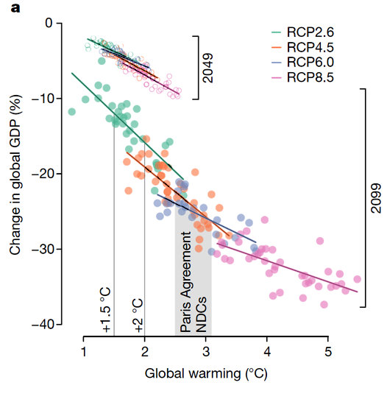
Cost of Climate Mitigation
Burke 2018 Nature
Empirical model of GDP versus T
Benefits of 1.5 degC exceed $50 trillion by 2100 w.r.t. 2.0 degC
5% chance it will exceed $100 trillion (10% loss per capita)
RCP8.5 is the path we are on … little chance of being within 3 degC
Notes:
Burke, M., W.M. Davis and N.S. Diffenbaugh 2018. Large potential reduction in economic damages under UN mitigation targets. Nature v.557 p.549-553.

Slide 42
In the end, it becomes a question of the social or moral cost if we don’t act
Inter-generational inequity
We are, in effect, using our children’s credit card
Question is: will future generations be wealthier or will climate change impose devastating consequences?
Inter-national inequity
Disproportionate burden relative to emission contribution.
Wealth inequity
Wealthy (countries, groups, or individuals) can adapt more easily
“Not in my backyard” solutions
Species inequity
Other species do NOT have the technology to adapt

Slide 43
How does USA compare to other countries?
USA: 700 briquet/day
Average person in world: 120 briquet/day
Notes:
Sanity Check: 1 t/person/year = 1000 kg/person/y
1000 kg/p/yr / 365 * 0.44 bag/kg * 100 briq/bag = 120.55 briq/p/day
6 tonnes/p/yr == 700 briq/p/day

Slide 44
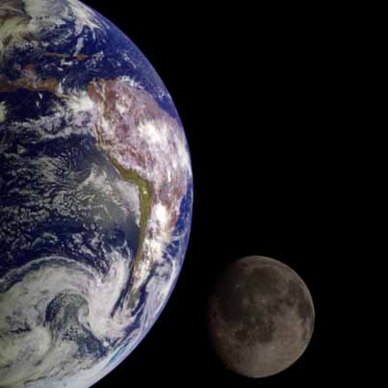
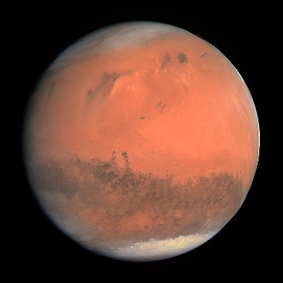
Maybe we should simply do what our ancestors did: leave this rock…
Moon, 239,000 miles away
Must bring oxygen and water (some small amounts of water may exist within polar craters).
Need protection for solar storms, etc.
Venus, 26 million miles away
Same size as Earth, but surface is 850 degF
Atmosphere is pure CO2, 92 bar pressure (would have to leave your laptop at home).
Mars, 49 million miles away
Atmosphere is pure CO2 (0.007 bar)
Has small (?) amounts of sub-surface water
Cold surface temperatures, large diurnal cycle
Can get to 70 degF at noon at equator
drops to -100 to -200 degF at night
Notes:
Moon: 0.2727 R_E, 0.0123 M_E, 0.167g
Venus: 243.5 day day, 0.82 M_E, 0.9082 g, 0.7233 AU, 0.62 year orbit
Mars: 24.633 hour day, 0.108 M_E, 0.3818 g, 1.5237 AU, 1.88 year orbit

Slide 45
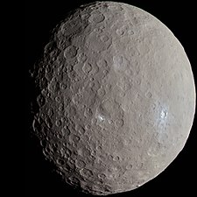
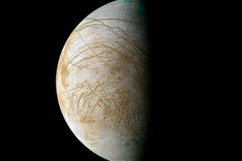
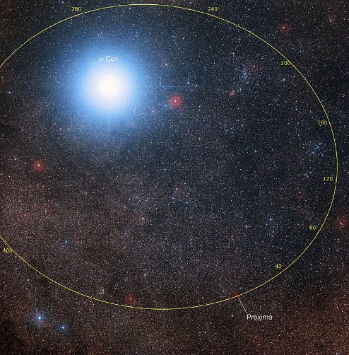
Other candidates?
Asteroid Ceres (600 mile diameter)
May have sub-surface ocean.
Europa (moon of Jupiter, 4.2 AU)
Ice moon, may harbor liquid water.
Surface temperature of -260 degF (maximum)
Titan (moon of Saturn, 9.5 AU)
1.5-bar Nitrogen atmosphere with methane rain, lakes.
Surface temperature is -180 degF
Proxima Centauri-B – 4.24 light years away
2017, discovered 1.27 M_{E} planet around our nearest star
0.0485 AU orbit about red dwarf, Te = 230 K +/- 10 K
most likely high UV emissions, uninhabitable
Could accelerate a camera to speed of 0.2 c
Deacceleration and orbit insertion would take significant time
would get there in ~40 years – pictures 4 years later
Transporting a few humans would take tens of 1000’s of years with current technologies … we will most likely know in the next decade if Proxima-B has an atmosphere, etc.
Aug. 2019, Proxima-C, ~2 AU, 4 M_{E}, Te=40 K (not habitable)
Notes:
CERES: 296 mile radius, 4.6 year orbit, 9 hour day, no atmosphere --- radiation problem
Iron-rich clays on surface (2006 Rivkin)
Titan: could create energy from H2+CH4, 1.5 bar atmosphere protects from radiation,
Has significant gravity. 5150 km diameter, 16 day orbit about Saturn
0.4042 R_E, 0.025 M_E
Europa’s ocean is probably several 10’s of km’s below the surface
Tidally heater, ~20km below surface, periodic plumes
0.2450 R_E, 0.00803 M_E
May have plate tectonics
Europa Clipper mission was proposed in 2014, status ????

Slide 46
Future directions for my talk
A couple of years ago a student asked – “what is the point of no return”
An extremely difficult question to answer.
My thinking is changing on how to convey the role of population, technology, and wealth equity
See Human and Nature DYnamics (HANDY) model (Motesharrei 2014 Ecol.Econ.)
Notes:
Motesharrei, S., J. Rivas and E. Kalnay 2014. Human and nature dynamics (HANDY): Modeling inequality and use of resources in the collapse or sustainability of societies. Ecological Economics v.101 p.90-102.
Graphic:
Type-L Collapse (Labor Disappears, Nature Recovers)
- same as the equilibrium without Elites case, here we set x_E(0) = 0.001
- very small initial seed of Elites
- Elite population starts growing significantly only after t=500
- collapses due to worker scarcity even though natural resources are still abundant
- Type-L collapse in which both Population and Wealth collapse but Nature recovers
Irreversible Type-N Collapse (Full Collapse)
- small initial seed of x_E(0) = 0.20, kappa = 100
- large depletion delta=15*delta_*=1.0e-4
- Wealth starts declining as soon as the Commoner's population goes beyond its carrying capacity
- full collapse takes only about 250 additional years
- Elites - who have unequal access to consumable goods (kappa=100) - eventually also die of hunger

Slide 47
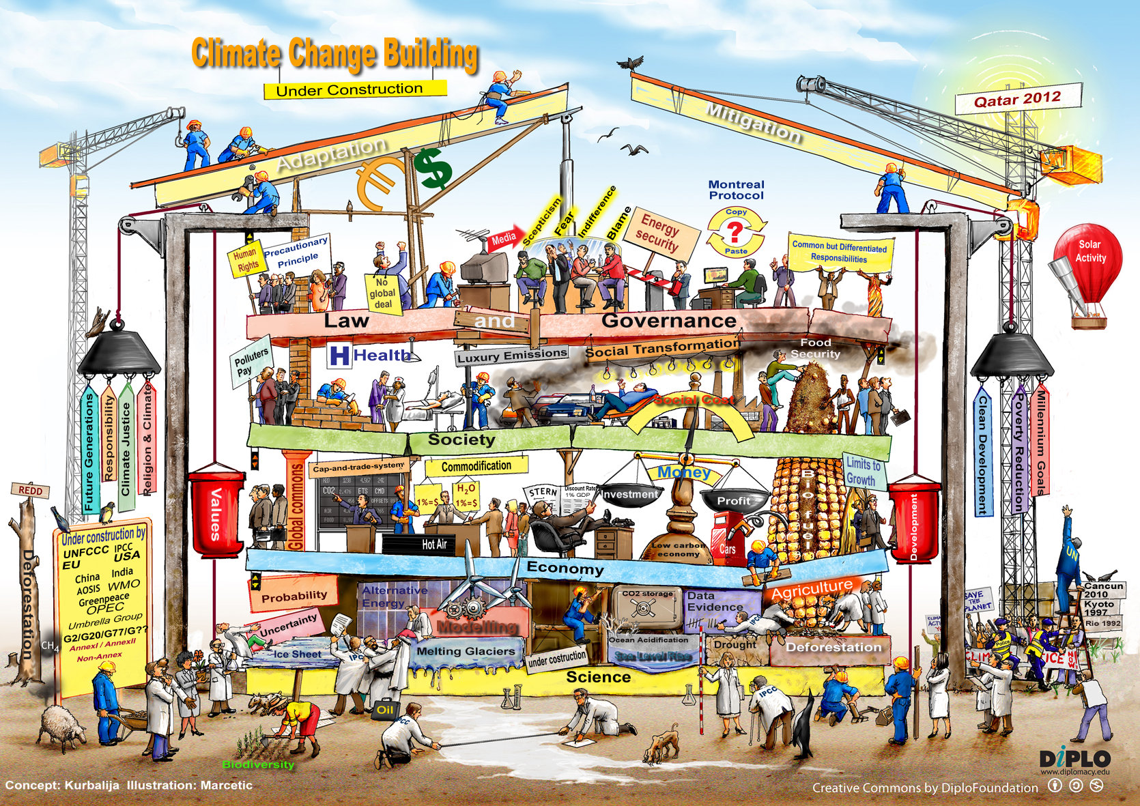
“Metaphors and Images” from: www.diplomacy.edu
https://www.diplomacy.edu/blog/metaphors-and-images-illustrating-climate-change

Slide 48
BACKUP
Notes:
Prodencia Atabongakeng, Science Teacher Laurel High School, 301-497-2050
Four classes total – each class had ~20 students
May 2, 2018 “B-day” 3rd and 4th period that is from 11:15 am to 2: 15 pm
- there was a senior event, so most of the seniors left after ~20 minutes
May 3, 2018 “A-day” 8:15 am to 10:30 am
- many of these students had difficulty with English
Annual update:
p. 4,5, Hansen’s fig a2
pg. : N.H. Extent Anomalies from NSIDC Sea ice Index page:
http://nsidc.org/data/seaice_index
pg. 31 personal carbon footprint
Print menu, Select: Note Pages, 1pg/pg (not an option) DO NOT Check include comments
In Properties: 2 page/page (portrait)
..or for more condensed.. In properties: 4 page/page, advanced:set scale to 88%
Or for simply the slides print “slides” w/ scale to fit=ON
- click on {properties} in upper right corner
- In {layout} set orientation to landscape mode and 16 pages per sheet
- click on advanced, set paper size = screen)
- then load PDF in acroread, reprint the resulting PDF file to 8x10 size (fit to printable area option in acroread)
University of Maryland, Baltimore, Date/Time: Feb. 14, 2017 11:00-12:00
Attending: ~12 students, Belay Demoz, Susan Hoban, Vanderlei Martins, 1 other
Start: ~11:05 End:12:02
Questions: 1) Belay: why do you keep track of details like gasoline
before I could tell others what to do, I wanted to understand
what I was doing
2) Student: are taxes a good idea?
Hansen’s tax idea vs. cap-and-trade
-----------------------------------------------------------------------
Feb. 3, 2015 Greenbelt Climate Action Network
ANNUAL CLIMATE CHANGE UPDATE with Chris Barnet
7:00 - 9:15 pm, Greenbelt Community Center, Room 114, 15 Crescent Road, Greenbelt, MD
~10 people Chris Nichols, Eric T. Norwood (ericnorwood27@yahoo.com),
Millicent Allenby (mitallenby@gmail.com)questions about east coast oil vs. wind, sent her the Kempton papers, Lore Rosenthal, Jon B. Sellin (jbsellin@aol.com, geologist – “got it mostly right”)
Things to add:
Discussion on ENSO mechanism, storage of ocean heat
Scale of problem: 100-Gt versus 1 Gt solutions are needed
Problems with Nuclear – do we really need it
---------------------------------------------------------------------------------
Sep. 28, 2015 Catholic Univ. (Sus.Arch) ~ 60 students (focus on Encyclical)
Talked from 9:40-10:30
Introduction to Sustainability course to our sophomore students
Mondays and Wednesdays from 9:40 – 10:55 am
class is 70 minutes
55 undergraduates and 6 graduates
Chris Grech, RIBA, Associate Professor, Center for Building Stewardship, Director Master of Science in Sustainable Design Program Director, The Catholic University of America School of Architecture and Planning, 620 Michigan Avenue NE Washington, DC 20064 USA T: 202-319-6398 <tel:202-319-6398> E: grech@cua.edu <mailto:grech@cua.edu>
W: http://architecture.cua.edu/academicprograms/MSSD.cfm
Vatican astronomer Guy Consolmagno
PhD from Arizona, Harvard fellow, NASA/GSFC visiting scientist, meterorite researcher, winner of the 2014 Carl Sagan Medal.
<a href="http://thecolbertreport.cc.com/videos/zwjey6/gold--frankincense-and-mars---guy-consolmagno"
target="_blank">2009, on Stephen Colbert</a>
Consolmagno has worked for John Paul II, who ordered the teaching of evolution in all Catholic schools, for Benedict XVI, who commissioned the report on climate change from the Pontifical Academy of the Sciences which led to Francis elevating the destruction of the climate to a moral issue. Benedict is actually known as "the Green Pope," because he did most of the groundwork for what Francis just wrote.
Bill Dinges, colleague from CUA School of Theology
teaches a course called Religion and Ecologyy
Questions:
Chris G.: what did you think of the encyclical?
A: My talk shows how difficult this problem is and how it will cost a lot and we basically get nothing in return except lowering the risk for future generations. So I think the encyclical fills a critical need to say that returning the Earth to how we found it is a moral obligation.
Student: Solar and wind is not carbon free.
A: I agree, there are issues with solar as to carbon emissions from the ground that the arrays cover. Plus there are carbon costs in production. But you have to look at the full life-cycle carbon. Relative to coal the life-cycle carbon cost is negligible.
Student: At what point is there no return?
A: There is a lot of discussion on this, but I think the answer is basically never. As we get to 2050 and beyond the effects will be more apparent and people will act, but it will be more difficult and cost more.
Student: you said that your generation caused the problem but your generation has also given us many tools and ideas that will help us solve th problem.
A: yes, but as a scientist we were aware of this in the 1960’s but continued to emit carbon. Recognize that the theory was done in the 1890’s and by the 1930’s was accepted and in the 1950’s was actually measured. So I would not be so forgiving.
Bill D.: Heard that encyclical only includes science that was accepted. Was this true?
A: yes, in fact I have shown a slightly more pessimistic view because that is what scientists are wrestling with today. The Encyclical and the IPCC only discusses published and confirmed results and as a result don’t factor in a lot of the potential risks.
Student: I haven’t heard the agricultural points before, is that new?
A: No, it is not new. It takes up ~500 pages {probably an exaggeration) in the IPCC and there are many scientific papers on this topic. The reason you have not heard it before is because our media prevents objective discussion on this topic. If you have a climate scientist on the news they are always accompanied by a non-climate specialist and they will say CO2 is green and CO2 is good for plants. You can’t have a discussion on agriculture because it becomes an argument before anything meaningful can be said. It is a hot topics in countries like India and China and in the USA we are not concerned because we are a wealthy country. But it might be a good idea to be friendly with the Canadians.
---------------------------------------------------------------
Feb. 3, 2015 Greenbelt Climate Action Network
Sep. 28, 2015 Catholic Univ. (Sus.Arch) ~ 60 students (focus on Encyclical)
Sep. 17, 2014 Catholic Univ. (Sus.Arch) ~ 60 students
Sep. 23, 2013 Catholic Univ. (Sus.Arch) ~ 60 students
Oct. 3, 2011 Catholic Univ. (Sus.Arch) ~ 100 students
Sep. 23, 2010 Catholic University, Sustainable Architecture Class, 105 students
Sep. 17, 2010 Catholic University, Alternative and Renewable Energy Class, 9 students
Apr. 15, 2010 Howard University, Beltsville Campus, Atmospheric Science Class (2.5 hours), questions at end
Nov. 11, 2009 GCAN meeting, Greenbelt Community Center, ~ 15 people (for slides search for’top 10 “discoveries” in 2009’)
Sep.28, 2009 Catholic University, Sustainable Architecture Class – reply to skeptical arguments - ~140 students attended
Sep. 4, 2009 Catholic University, Renewable Engineering Class, ~25
Apr. 22, 2009 Catholic University, Earth Day event ~ 200
Apr. 9, 2009 UMCP AOSC 434/658 2:00-3:15 CSS 2416
Feb. 11, 2009 GCAN meeting, Greenbelt Community Center
Sep. 10, 2008 Catholic University, Architecture class
May 29, 2008 Robert Goddard French Immersion School, 8th grade science class.
Mar. 12, 2008 Greenbelt Climate Action Network, Greenbelt Comm. Center
Feb. 29, 2008 Berwyn Heights Elementary School, 6th grade class
Jan. 31, 2008 Oxon Hill High School – Focus the Nation Event
Nov. 7, 2007 Greenbelt Town Hall Meeting

Slide 49
Common Assertions by Deniers
Recent warming is caused by the Sun | False, largest warming has occurred during an extended solar minimum Solar cycle is ± 0.1 K. Cannot explain the 0.9 K of warming. Solar warming would be greatest at equator. We see poles warming fast.
Warming will increase low clouds and this will cool the Earth | Maybe, but recent measurements have indicated that changes in clouds may be warming the Earth Even if clouds cooled the Earth the additional CO2 will continue to make the oceans more acidic, seasons will continue to shift, regional biosphere changes will still occur.
Notes:
Recent solar minimum and impacts of a long-term solar minima:
weakest sunspot cycle in 200 years (Cowen 3/26/2011 Science News, p.5-6)
Next solar cycle may be a no-show (Cowen 7/16/2011 Science News, p.12 )
Feulner, G. and S. Rahmstorf 2010. On the effect of a new grand minimum of solar activity on the future climate on Earth. Geophys. Res. Lett. v.37 L05707 doi:10.1029/2010GL042710, 5 pgs. - “any offset of global warming due to a Grand Minimum of solar activity would be merely a temporary eect, since the distinct solar minima during the last millennium typically lasted for only several decades or a century at most”
Clouds are a positive feedback:
Kerr, R.A. 2009. Clouds appear to be big, bad player in global warming. Science v.325 p.376-376.
Clement, A.C., R. Burgman and J.R. Norris 2009. Observational and model evidence for positive low-level cloud feedback. Science v.325 p.460-464.
Dessler, A.E. 2010. A determination of the cloud feedback from climate variations over the past decade. Science v.330 p.1523-1527.
Soden, B.J. and G.A. Vecchi 2011. The vertical distribution of cloud feedback in coupled ocean-atmosphere models. Geophys. Res. Lett. v.38 L12704 doi:10.1029/2011GL047632, 6 pgs.

Slide 50
Common Assertions by Deniers
It has been warmer in the geologic past 125,000 years ago: +1 C 3,000,000 years ago, +5 C | True, but sea levels were also higher and there were not 9 billion humans dependent on a stable ecosystem.
Climate has always changed | True, but society (including agriculture) developed during a remarkably stable period. Rate of change in CO2 and T is unprecedented in the historical record and it is unknown how this will effect services our ecosystems provide.
Notes:
Figure from E. Robert Thieler, Research Geologist, U.S. Geological Survey, July 25, 2011 presentation available at http://www.smrconference.com/workshops/index.cfm#Climate

Slide 51
Common Assertions by Deniers
Wind, solar, and geo-thermal energy are too expensive. | Fossil fuels (and nuclear energy) are heavily subsidized Fossil fuel price does not include its full environmental cost With full life-cycle cost accounting, wind and concentrated solar are extremely competitive now and cost of solar-cells are not far behind. Energy choices we make today will last 50-100 years. Wind, solar, and geo might be more predictable and dependable in the future – how much is that worth?

Slide 52
Common Assertions by Deniers
Cap-and-trade or carbon taxes would destroy our economy. | Is persistent economic growth really guaranteed with fossil fuels? Current price of fossil fuel is a “market failure” and future taxpayers (you!) will be paying the cost of our inaction. Cost of oil, coal, and gas will most likely increase as easy sources are exhausted Some argue that carbon taxes could be the only long-term stable economy
Notes:
Figure from Lackner, K.S., C.H. Wendt, D.P. Butt, E.L. Joyce and D.H. Sharp 1995. Carbon dioxide disposal in carbonate minerals. Energy v.20 p.1153-1170.

Slide 53
And … Climate change is affecting the ecosystem that we rely on
Ocean food-web is directly affected
Absorption of CO₂ causes acidification of ocean (erode calcite shells)
4 kg-CO2/person/day – largest rate of acidification in 300 Million years!
Shift in the seasons due to both T and CO₂
Interaction of species and terrestrial food web (fish spawning, bird migration, hibernation cycles)
Crops are genetically homogeneous and vulnerable
Impact on evaporation and seasonality of fresh water (snow and glacial melt)
99% certain that anthropogenic emissions are causing ocean acidification and shift in seasons
Many ecosystem services are already vulnerable due to population growth, pollution, etc.
Climate change adds greater uncertainty and risk to the future
Most of these changes are already “in the pipeline”
Large uncertainty in how biosphere will respond
huge risks for future generations
Notes:
Rate of acidification is larger than any time in last 300 My
4 kg-CO2/person/day into the oceans (Sep. 2014 WMO GHG Bulletin)
Coefficient of expansion of seawater, E ≅ 250e-6/K at 20 degC = {1/V}*dV/dT (pure water = 207e-6)
Volume{ocean} = 1.350E18 m^3 Area{ocean} = 3.620E14 m^2
E*V = 3.375E14 m^3/K
E*V/A = 0.9232 m/K
At 0.1 K/decade: 0.092 m/decade = 0.009 m/y = 9 mm/y (off by factor of 20 due to depth assumption)
[Leuliette 2011 Oceanography] steric part is 0.7 mm/yr (900 meters), 1000-4000 meters is 0.1 mm/y
E = SLR_{steric}(mm/y)*A/V/10 = 0.5*3.52E-5/1.35 = 1.3e-5/K

Slide 54
How will the world crops react to higher temperatures?
With C4 plants (e.g., corn and cotton) the CO2 absorption is already saturated
40% of world's grain harvest will not improve with increased CO2
C4 plants have greater drought tolerance due to low evaporation
With C3 plants (e.g., soybean, wheat, and rice) improve yields with increasing CO2
All plants respire more CO2 with higher temperatures
C4 plants may prosper in arid climates (Morgan 2011 Nature)
Non-linear T effects will cause decreased corn, soy, and cotton yields if T rises above critical threshold
Corn Tc=29°C, soybeans Tc=30°C, cotton Tc=32°C
~20% decrease in global crop yield by 2050
~40%(B1) to 80%(A1FI) decrease in global crop yield by 2100
Lower crop yields could increase “climate refugees”
4.2 million additional adult (15-65y old) Mexicans could emigrate to USA by ~2080 due to 10% lower crop yields
Notes:
Mexico to USA migration: Feng, S., A.B. Krueger and M. Oppenheimer 2010. Linkages among climate change, crop yields and Mexico-US cross-border migration. Proc. Nat'l Acad. Sci. v.107 p.14257-14262
C4 plants already saturated Leakey, A.D.B. 2009. Rising atmospheric carbon dioxide concentration and the future of C-4 crops for food and fuel. Proc. R. Soc. B. v.276 p.2333-2343. doi:10.1098/rspb.2008.1517
Trends since 1980: Lobell, D.J., W. Schlenker and J. Costa-Roberts 2011. Climate trends and global crop production since 1980. Science v.333 p.616-620. Corn -3.8%, Rice +2.9, Wheat -2.5, Soy +1.3
Critical T: Schlenker, W. and M.J. Roberts 2009. Nonlinear temperature effects indicate severe damages to US crop yields under climate change. Proc. Nat'l Acad. Sci. v.106 p.15594-15598. doi:10.1073/pnas.0906865106
Morgan, J.A., D.R. LeCain, E. Pendall, D.M. Blumenthal, B.A. Kimball, Y. Carrillo, D.G. Williams, J. Heisler-White, F.A. Dijkstra and M. West 2011. C4 grasses prosper as carbon dioxide eliminates desiccation in warmed semi-arid grassland. Nature v.476 p.202-205.
Challinor, A.J., D.B. Lobell and et al. 2014. A meta-analysis of crop yield under climate change and adaptation. Nature Climate Change doi:10.1038/NCLIMATE2153, 5 pgs
Thornton, P.K., P.G. Jones, P.J. Ericksen and A.J. Challinor 2011. Agriculture and food systems in sub-Saharan Africa in a 4 degC+ world. Phil. Trans. R. Soc. Lond. A v.369 p.117-136
Teixeira, E.I., G. Fischer, H. van Velthuizen, C. Walter and F. Ewert 2013. Global hot-spots of heat stress on agricultural crops due to climate change. Agricultural and Forest Meteorology v.170 p.206-215.

Slide 55
CO2 is good for agriculture, right? Climate models do not assess weeds vs. crops
Cultivated crops tend to be genetically selected whereas weeds are diverse, who wins on the field?
Amaranthus retroflexis (C4) versus Soybean | Crop | Ziska 2000
Amaranthus retroflexus (C4) versus Sorghum | Weed | Ziska 2003
Chenopodium album (C3) versus Soybean | Weed | Ziska 2000
Taraxanum officinale (C3) versus Lucerne | Weed | Bruce 1995
Albutilion theophrasti (C3) versus Sorghum | Weed | Ziska 2003
Taraxanum and Plantigo (C3) versus Grasses | Weed | Potvin & Vasseur 1997
Some evidence that rising CO2 may select C3 weeds or invasive species over existing (possibly stressed) biomass.
Invasive species in the USA – a $13 billion/yr problem
8 million acres of Kudzu – has moved from southern Illinois, mid-Kentucky in 1971 to mid-Illinois/Indiana, and southern Ohio in 2004.
Study of minimum temperature thresholds versus time indicates it could migrate to upper Wisconsin, Michigan by 2020.
60 million acres of cheatgrass in western USA
Dries 4-6 weeks earlier than perennials
Grows in low precipitation areas (6 to 22 inches/yr) and readily ignites.
Can dramatically change fuel-load and ignition sensitivity of a region.
As CO2 increases, herbicide efficacy is reduced.
Notes:
Table from Climate Change and Plant Biology: A walk on the wild (nature) side.
A presentation by Lewis H. Ziska, USDA-ARS, Crop Systems and Global Change Lab.
On Feb. 14, 2008
cheatgrass (Bromus tectorum)

Slide 56
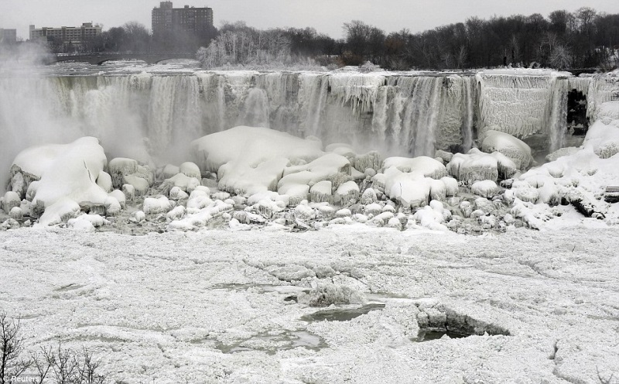
But wait, hasn’t global warming stopped?
If we look back a century, we find cold anomalies that dwarf todays.
Portions of Niagara Falls froze in 1902, 1936, 1938.
Feb. 1899 temperature fell to -2 F in Tallahassee Florida
Recent years (2009,11,12,13,14) have had extreme negative Arctic Oscillation (high pressure in Arctic)
East coast of USA was “unusually cold”
e.g., Feb. 4-5, 2010 “Snowmaggedon”
Jan. 8, parts of Niagara Falls froze
This is an exchange of air and not a “global” cooling.
1902 (above) and Jan. 8, 2014 (below)
Notes:
Pictures from Hansen e-mail notes, Jan. 2010 (100127hansen_temp_essay.pdf)
American side of Niagara Falls froze over twice: 1936, 1938

Slide 57
There are three definitions of the word apprehend
(verb) To understand or perceive:
The measurements and models allow us to apprehend the changes in climate
(adj.) To anticipate with anxiety, suspicion, or fear:
We are apprehensive about increases in sea level rise and food insecurity.
(verb) To arrest or seize:
We should apprehend carbon gases before they enter the atmosphere.

Slide 58
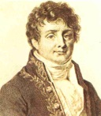
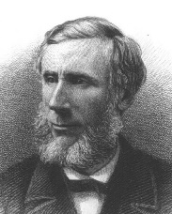
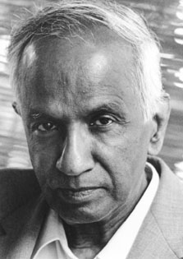
Science is an intricate web
Joseph Fourier (1768-1830)
Global warming theory is based on radiative transfer
Developed by physicists of the 19th and 20th centuries
1827 Joseph Fourier discovers infrared “greenhouse” effect
1863 John Tyndall discovered infrared opacity of CO₂ and H₂O
1896 Svante Arrhenius, 1st estimate of sensitivity (5 deg-K/2xCO₂)
Radiative transfer is used in weather models, theories of stars (e.g., our Sun, supernovas, black holes), planets, nuclear fission & fusion, heat seeking missiles, radio & television, microwave ovens, cell phones, etc.
1950 Chandrasekar publishes detailed theory of radiative transfer
Scientists speak in terms of the probability of a theory or measurement explaining a phenomena
To a scientist, a question as simple as whether or not the sun rise tomorrow can be met with a reasonable skepticism
If a theory, such as global warming, is wrong then it has major implications for all science
John Tyndall (1820-1893)
Svante Arrhenius (1859-1927)
Subrahmanyan Chandrasekhar
(1910-1995)
Notes:
This slide derived from Pierrehumbert, R.T. 2011. Infrared radiation and planetary temperature. Physics Today v.1 p.33-38.
Pictures of
Joseph Fourier (1768-1830)
Ludwig Boltmann (1844-1906)
Svante Arrenhius (1859-1927)
Max Planck (1858-1947)
Albert Einstein (1879-1955)
Subrahmanyan Chandrasekhar (1910-1995)

Slide 59
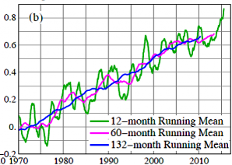
Has there been a “hiatus”
Climate deniers say the models cannot explain the recent lack of rise in temperature
Some scientists argue there has been no “hiatus”
e.g., (Karl 2015 Science)
2016/2015 warming (+0.45° F) is due to strong El Nino in Pacific
This could be a climate shift back to pre-1998 growth rates
Hiatus virtually disappears with 5 year (60 month, cyan) or 11 year (132 month blue) smoothing of global temperature measurements
Notes:
Figure from “Global Temperature in 2015”, 19 January 2016 Essay by
James Hansen, Makiko Sato, Reto Ruedy, Gavin A. Schmidt, Ken Lo
Karl, T.R., A. Arguez, B. Huang, J.H. Lawrimore, J.R. McMahon, M.J. Menne, T.C. Peterson, R.S. Vose and H.M. Zhang 2015. Possible artifacts of data biases in the recent global surface warming hiatus. Science v.348 p.1269-1272.
Recent article accuses Karl of rushing article to press: http://www.dailymail.co.uk/sciencetech/article-4192182/World-leaders-duped-manipulated-global-warming-data.html
Detailed discussion of accusation by John Bates: https://judithcurry.com/2017/02/04/climate-scientists-versus-climate-data/
Debunked by Zeke Hausfather: https://www.carbonbrief.org/factcheck-mail-sundays-astonishing-evidence-global-temperature-rise
Has a nice You-tube discussion: https://www.youtube.com/watch?v=hnyX32nkYBs&feature=youtu.be

Slide 60
When will we know if the theory of global warming is true or false?
Each year, it becomes more difficult to deny changes are occurring.
Btu you need to compare current weather to when you were a child.
The probably of a “warm summer” is now the norm
Winter has more extremes, so slow changes are less noticeable.
Notes:
Figure from “Global Temperature in 2015”, 19 January 2016 Essay by
James Hansen, Makiko Sato, Reto Ruedy, Gavin A. Schmidt, Ken Lo

Slide 61
20th century surface temperature: Natural forcings can’t explain growth
ENSO: short-term and mostly tropical
Volcanic aerosols: episodic, mid-latitude
Solar: 11-year cycle, mid-latitudes
Anthropogenic: long-term growth, global
Solar fingerprint is reliably detected and only contributes ±0.1 K and a very small trend (+0.007 ± 0.001 K/decade over 20th century, +0.004 ± 0.004 K/decade in last 30 years)
Anthropogenic signals (GHG’s, aerosols, and land/snow feedbacks) are global and have an accelerated trend (+0.051 ± 0.001 K/decade over 20th century, +0.199 ± 0.005 K/decade in last 30 years
Notes:
Lean, J.L. and D.H. Rind 2008. How natural and anthropogenic influences alter global and regional surface temperatures: 1880 to 2006. Geophys. Res. Lett. v.35 L18701 doi:10.1029/2008GL034864, 6 pgs.
solar trend over last century and decade
Feulner, G. and S. Rahmstorf 2010. On the effect of a new grand minimum of solar activity on the future climate on Earth. Geophys. Res. Lett. doi:2010GL042710 (in press), 10 pgs.
Song, X., D. Lubin and G.J. Zhang 2010. Increased greenhouse gases enhance regional climate response to a Maunder Minimum. Geophys. Res. Lett. v.37 L01703 doi:10.1029/2009GL041290, 6 pgs.

Slide 62
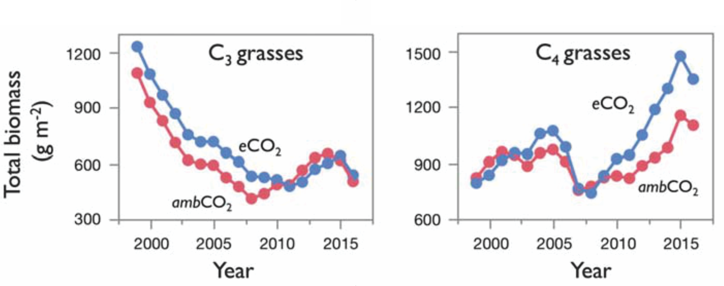
Changes to biology
Reich 2018 Science
Unexpected reversal of C3 grass response to elevated CO2 (eCO2) during a 20 year experiment
Previous experiments only ran for a few years
Note: initial decrease of biomass is due to tillage (freeing nutrients), before planting the experimental plots
net N mineralization to eCO2 in C4 grass plots became more positive over time
Notes:
C3 and C4 are the two dominant photosynthetic mechanisms of plants. Terrestrial models treat C3 plants as sensitive to CO2 fertilization, C4 plants not. This has been observed many times in experiments. They typically ran for a few years. Shown is the experiment that has run the longest. Half of the experimental plots are surrounded by tubes that emit CO2, enhancing the natural “ambCO2” levels by 180 ppm “eCO2”. After about 10 years, the response of C3 and C4 reverses! The models are wrong when run for predictions over decades.
For physiological reasons C3 is supposed to respond to higher CO2 by increasing its rate of photosynthesis (Rubisco also catalyzes oxidation). [Note: The initial decrease of biomass is due to tillage (freeing nutrients), before planting the experimental plots.]
============================================================
[Baldocchi 2011 Nature] The grass response
-------------------------------------------------
- C4 grasses are more efficient photo-synthesizers as a result of
their distinct morphology and their use of another enzyme, PeP-carboxylase
- photosynthesis is stimulated when leaves are exposed to above-ambient levels of CO2
- eventually diminish and approach an asymptote as CO2 levels reach double that of the present day

Slide 63
90% certain that temperature increase is due to the rise in GHG
The future temperature increase depends on how the Earth system responds to the added CO2 (and also N2O, CH4)
Well known that doubling CO2 (2xCO2) will warm Earth’s surface by 1.2 degC
Also well known that adding CO2 will cool Earth’s stratosphere
Albedo feedback” is a positive feedback
ice/snow reflect more than ocean/land
polar regions will warm faster as ice melts
Water vapor feedback is a positive feedback
Water vapor increases 7% per degC
Will increase warming ~1 degC per doubling of CO2
Aerosols and clouds are big uncertainties
Sulfate aerosols (from coal plants, volcanoes) cool the Earth.
Black carbon (soot from burning fossil) warms the Earth.
An increase of high (low) clouds will warm (cool) the surface.
Biosphere (i.e., carbon cycle) can have a big impact
CO2 fertilization is increasing (a negative feedback)
Loss of trees due to wildfires adds CO2 (a positive feedback)
Every year the compounded warming induced by CO₂ makes uncertainties matter less and less

Slide 64
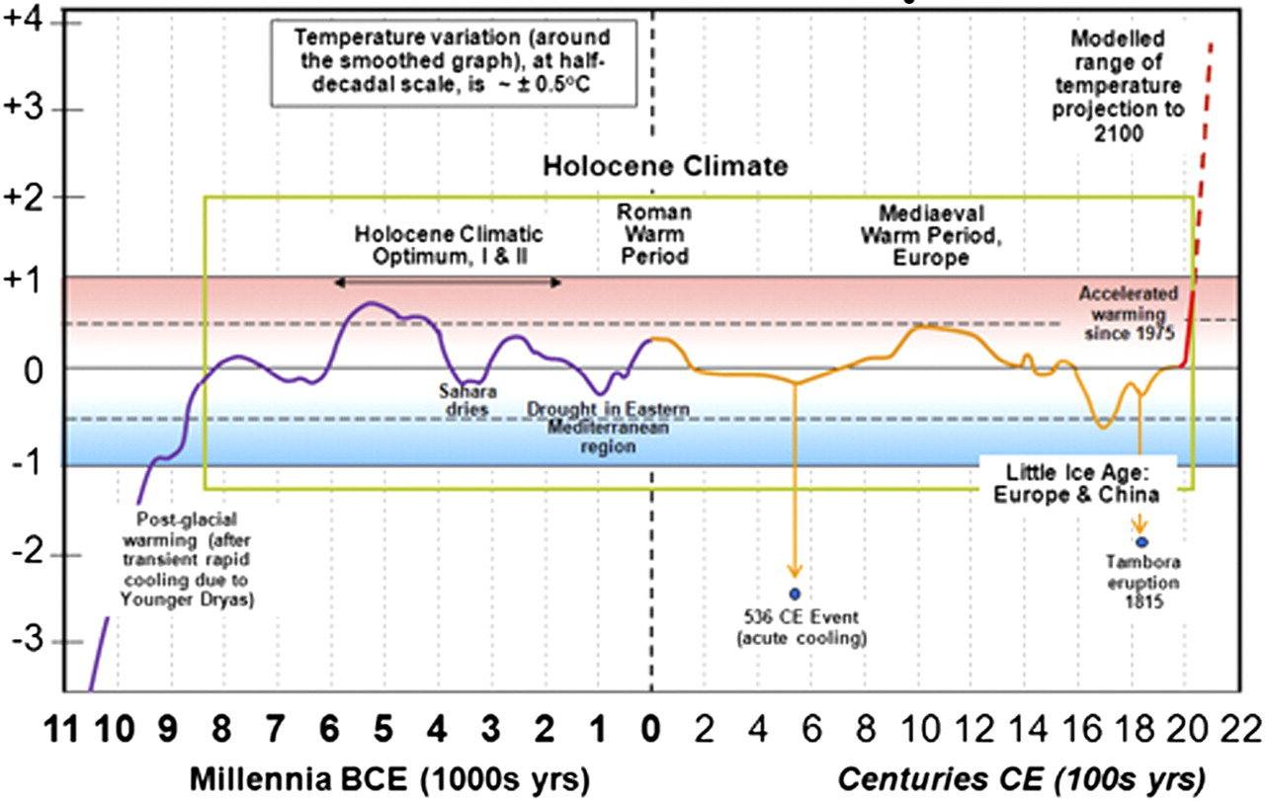
How significant is this rise in global surface temperature?
Current average Earth temperature is beginning to exceed the variability of last 13,000 years
Current rate of rise is without precedent during the Holocene
Holocene is the period where most of human civilization (agriculture, etc) was realized
It is most likely that the -5 deg Celsius glacial climate caused redistribution of population and population “bottlenecks.”
Notes:
McMichael, A.J. 2012. Insights from past millennia into climatic impacts on human health and survival. Proc. Nat'l Acad. Sci. v.109 p.4730-4737.

Slide 65
What can the past tell us?
Climate was warmer at times when humans were not burning fossil fuels
Some previous inter-glacials were longer and warmer
Deglaciations initiated by solar insolation changes in N.H.
Feedbacks caused a release of CO2
CO2 caused a rapid global rise in temperature
Natural geologic CO2 emissions occurred in the past
Tectonic/volcanic high CO2 is associated with extinctions
Some of the fossil fuels that we are burning today are from these high-CO2 climates of the past
Is their an analog for our future climate?
Short answer is no.
Rate of conversion of fossil carbon to atmospheric carbon is larger than at any known period of the past

Slide 66
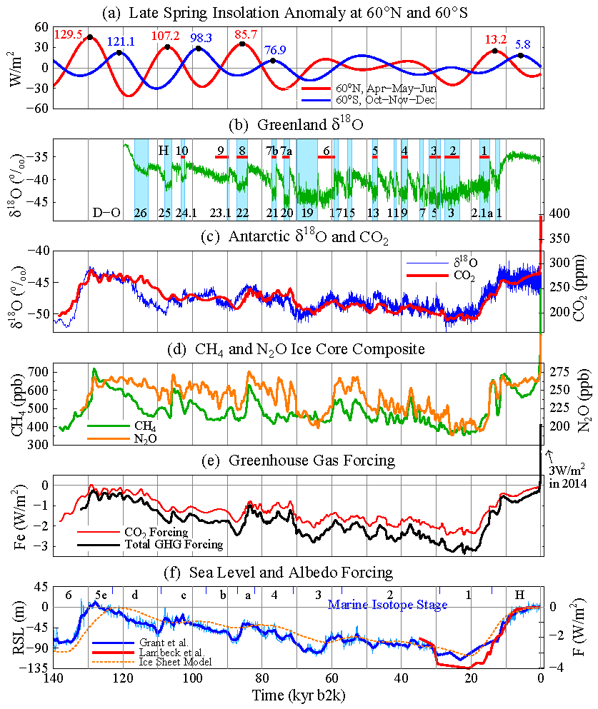
Eemian interglacial, 125,000 years ago
Solar eccentricity was larger (0.042) than today (0.017)
greater seasonal extremes.
Summer warming in continental interiors was greater.
+4C in Eurasia
Sea level rise may have risen rapidly (3’/100-year) at end of Eemian
May have risen 6-9 meters
Evidence that Atlantic ocean circulation may have slowed
Evidence (in Bahama’s) of increased storminess (due to melt cooling in north, warming in tropics)
Notes:
Billups, K. 2015. Timing is everything during deglaciations. Nature v.522 p.163-164.
Bohm, E., J. Lippold, M. Gutjahr, M. Frank, P. Blaser, B. Antz and J. Fohlmeister 2014. Strong and deep Atlantic meridional overturning circulation during the last glacial cycle. Nature v.517 p.73-76.
Dutton, A., A.E. Carlson, A.J. Long, G.A. Milne, P.U. Clark, R. DeConto, B.P. Horton, S. Rahmstorf and M.E. Raymo 2015. Sea-level rise due to polar ice-sheet mass loss during past warm periods. Science v.349 10.1126/science.aaa4019, 10 pgs.
Hansen, J., M. Sato, P. Hearty, R. Ruedy, M. Kelley, V. Masson-Delmotte, G. Russell, G. Tselioudis, J. Cao, E. Rignot, I. Velicogna, E. Kandian, K. von Schuckmann, P. Kharecha, A.N. Legrande, M. Bauer and K.W. Lo 2015. Ice melt, sea level rise and superstorms: evidence from paleoclimate data, climate modeling, and modern observations that 2 degC global warming is highly dangerous. Atmos. Chem. Phys. (Discuss.) v.15 p.20059-20179.
Hayes, C.T. and et al. 2014. A stagnation event in the deep South Atlantic during the last interglacial period. Science v.346 p.1514-1517.
Lamy, F. and et al. 2014. Increased dust deposition in the Pacific southern ocean during glacial periods. Science v.343 p.403-407.
Marino, G., E.J. Rohling, L. Rodriguez-Sanz, K.M. Grant, D. Heslop, A.P. Roberts, J.D. Stanford and J. Yu 2015. Bipolar seesaw control on last interglacial sea level. Nature v.522 p.197-201.
Martin, E.E. 2014. Ocean circulation and rapid climate change. Nature v.517 p.30-31.
Zhang, X., Lohmann, G, G. Knorr and C. Purcell 2014. Abrupt glacial climate shifts controlled by ice sheet changes. Nature v.512 p.290-294.

Slide 67
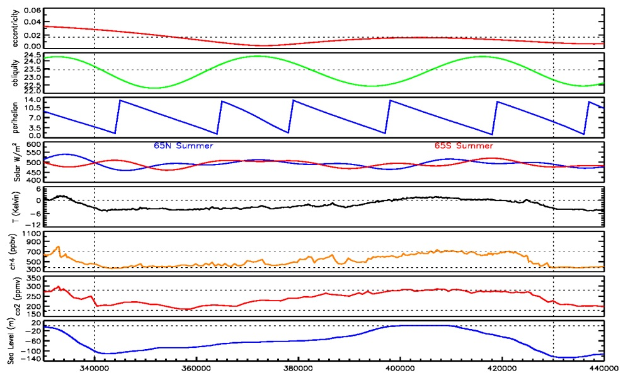
Is the Holsteinian - 430,000 years ago – an analogue to Holocene?
Marine Isotope Stage (MIS) 11 was an inter-glacial with similar Earth orbit conditions as now (low eccentricity)
This interglacial lasted a long time (50,000 years).
Sea level rise was +6 to +11 meters higher than today
Pollen count samples in ocean sediments were order of magnitude higher than today
Presence of forest vegetation in Greenland supports idea that sea level was higher.
Notes:
de Vernal, A. and C. Hillaire-Marcel 2008. Natural variability of greenland climate, vegetation, and ice volume during the past million years. Science v.320 p.1622-1625
21 meters: Olson, S.L. and P.J. Hearty 2010. A sustained +21 m highstand during MIS 11 (400 ka): direct fossil and sedimentary evidence from Bermuda. Quaternary Science Reviews v.28 p.271-285
Raymo, M.E. and J.X. Mitrovica 2012. Collapse of polar ice sheets during the stage 11 interglacial. Nature v.483 p.453-456.
Melles, M., R.M. DeConto and et al. 2012. 2.8 million years of Arctic climate change from Lake El'gygytgyn, NE Russia. Science v.337 p.315- 320. (obs at Lake El'gygytgyn, located ~100 km to the north of the Arctic Circle in northeastern Russia, 67.5d N, 172d E)

Slide 68
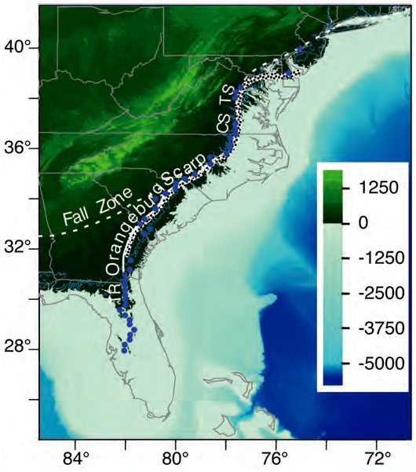
Is the Pliocene 3 to 5 million years ago an analogue for our future?
Central American (Panama) isthmus was open before ≈ 5.5 million years ago (Mya)
Closure decreased ocean heat transport
caused long-term cooling of N.H. at ~2.7 Mya
Northern temperatures seasonally +10C warmer
Antarctic sea surface temperatures were +6 to +10 C
Greenland and Arctic ice sheets were reduced
Possibility of permanent El Nino-like state 3-4.5 Mya
Very high climate sensitivity from 3 to 4.2 Mya
2.4
Mya
3.4
Orangeburg scarp (from MD eastern shore to Georgia) is Pliocene shoreline
evidence of +12 to +32 meter sea level 2.9 to 3.3 Mya
Derived climate sensitivity
4 to 4.2 Mya | 3 to 3.3 Mya
+90-125 ppm | +90-125 ppm
+4 C | +2.4 to 2.9 C
9.6 ± 1.4 K/2xCO2 | 7.1 to 8.7 ± 1.3 K/2xCO2
Notes:
Pliocene SLR was globally ~12 to 32 meters 2.9-3.3 Mya is from Rohling, E.J., G.L. Foster, K.M. Grant, G. Marino, A.P. Roberts, M.E. Tamisiea and F. Williams 2014. Sea-level and deep-sea-temperature variability over the past 5.3 million years. Nature v.508 p.477-482.
Closest analog might be 2.7 Mya (Honisch 2009 Science v.324 p.1551)
0 to 25 Mya from Fig.3b of Pearson 2000 Nature v.406, p.695 CO2 vs time for 25 My (measured pH from Boron-isotopes, inferred CO2)
2.4-3.4 Mya CO2 from Tripati, A.K., C.D. Roberts and R.A. Eagle 2009. Coupling of CO2 and ice sheet stability over major climate transitions of the last 20 million years. Science on-line 10/8/2009, 6 pgs.
Permanent El-Nino-like state: Wara, M.W., A.C. Ravelo and M.L. Delaney 2005. Permanent El Nino-like conditions during the Pliocene warm period. Science v.309 p.758-761.
Fedorov, A.V., C.M. Brierley and K. Emanuel 2010. Tropical cyclones and permanent El Nino in the early Pliocene epoch. Nature v.463 p.1066- 1070. (his fig.1 on right)
High climate sensitivity:
Lunt, D.J., A.M. Haywood, G.A. Schmidt, U. Salzmann, P.J. Valdes and H.J. Dowsett 2010. Earth system sensitivity inferred from Pliocene modelling and data. Nature Geoscience v.3 p.60-64.
Pagani, M., Z. Liu, J. LaRiviere and A.C. Ravelo 2009. High Earth-system climate sensitivity determined from Pliocene carbon dioxide concentrations. Nature Geoscience v.3 p.27-30 (9.6 +/- 1.4 from 4 to 4.2 Mya and 7.1 to 8.7 +/- 1.3 from 3 to 3.3 Mya)
+25m and sea level figure: Rowley, D.B., A.M. Forte, R. Moucha, J.X. Mitrovica, N.A. Simmons and S.P. Grand 2013. Dynamic topography change of the eastern United States since 3 million years ago. Science v.340 p.1560-1563.

Slide 69
Where we might be headed: the Eocene 55.8 to 33.9 million years ago
Ice-free world
Sea level was +75 meters
Extensive seaway to the south of Europe/Asian
Ice free polar regions
Uplift of Alps, Rocky’s
Impact on atmospheric circulation.
Increased weathering
Panama passage still open, different meridional ocean circulation.
Drake passage was still closed.
Different mechanisms for CO₂ ocean-atmosphere exchange.
North Atlantic Igneous Province could be reason for enhanced CO₂
CO2 was higher (800 ppmv ?)
Tropical T’s were +5C
Implies no infrared “iris” effect
42’ boid snake in Columbia (2009 Nature) consistent w/ warm tropics
Notes:
Crowley 1990 Science – uplift of Alps, Rocky’s and Himalayas
Huber 2008 Science
Pearson and Palmer 1999 +5C
Head 2009 Nature – 42’ boid snake
Pearson 2000 Nature
Fletcher 2008 Nature = 600 ppmv ay 60 Mya
50 Mya to present solar irradiance has been increasing while T is dropping. CO2 went from 1500 ppm (50 Mya) to present

Slide 70
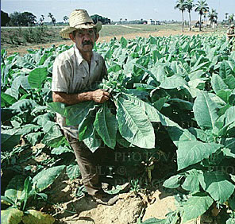
And response of plants can affect human health and comfort.
Allergies and Asthma
Ragweed pollen production at 370 ppmv is 10.9 g/plant
At 600 ppmv it is almost double (20.5 g/plant)
Contact dermititis
Poison ivy grows faster at elevated CO2
And is more potent in urushiol (the oil that causes the rash)
Poison and Toxicology
Castor beans produce ricin, one of the most deadliest poisons known to man. Increasing CO2 by 300 ppm increases net productivity 34%.
3-4x increase in alkaloid production in wild plants (Morphine, Codeine, Cocaine, Caffeine, Nicotine)
Notes:
Ragweed and Poisen Ivy – Ziska, L. USDA e.g. 2006 PNAS v.103 p.9086 – Poison Ivy

Slide 71
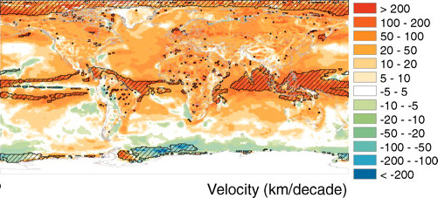
How will nature respond to climate change? An analysis of 1960-2009
Velocity of temperature change is more than 1 mile/year (16 km/decade) in most places
At the end of the last ice age trees moved ~0.05 mile/y
Modern landscape is fragmented: difficult for migration
Butterflies have been seen to move ~4 mile/y
One species of bush cricket measured at ~5 mile/y
Big concern is emergence of novel ecosystems
What is the impact on ecosystem services (food,, fresh water, lumber)
New ecosystems will have different mix of species.
Notes:
Burrows, M.T. and et al. 2014. Geographical limits to species-range shifts are suggested by climate velocity. Nature v.507 p.492-495.
Burrows, M.T. and et al. 2011. The pace of shifting climate in marine and terrestrial ecosystems. Science v.334 p.652-655 (figure 1c shown above)
Dirzo, R. and et al. 2014. Defaunation in the Anthropocene. Science v.345 p.401-406.
Dornelas, M. and et al. 2014. Assemblage time series reveal biodiversity change but not systematic loss. Science v.344 p.296-299.
Fraedrich, K., F.W. Gerstengarbe and P.C. Werner 2001. Climate shifts during the last century. Climatic Change v.50 p.405-417. doi:10.1023/A:1010699428863
Garcia, R.A., M. Cabeza, C. Rahbek and M.B. Araujo 2014. Multiple dimensions of climate change and their implications for biodiversity. Science v.344 p.486-486.
Loarie, S.R., P.B. Duffy, H. Hamilton, G.P. Asner, C.B. Field and D.D. Ackerly 2009. The velocity of climate change. Nature v.462 p.1052-1055.
Marris, E. 2011. The end of the wild. Nature v.469 p.150-152.
Mora, C. and et al. 2014. reply to Hawkins et al., "Uncertainties in the timing of unprecedented climates.". Nature v.511 Letters, E5-6, 2 pgs.
Mora, C. and et al. 2013. The projected timing of climate departure from recent variability. Nature v.502 p.183-187.
Ohlemuller, R., E.S. Gritti, M.T. Sykes and C.D. Thomas 2006. Towards European climate risk surfaces: The extent and distribution of analogous and non-analogous climates 1931-2100. Global Ecology Biogeogr. v.15 p.395-405. doi:10.1111/j.1466-822X.2006.00245.x (motion of trees, butterflies and cricket)
Pandolfi, J.M. and C.E. Lovelock 2014. Novelty trumps loss in global biodiversity. Science v.344 p.266-267.
Pimm, S.L., C.N. Jenkins, R. Abell, T.M. Brooks, J.L. Gittleman, L.N. Joppa, P.H. Raven, C.M. Roberts and J.O. Sexton 2014. The biodiversity of species and their rates of extinction, distribution, and protection. Science v.344 doi:10.1126/science/1246752, 11 pgs.
Sandel, B. and et al. 2011. The influence of late quaternary climate-change velocity on species endemism. Science v.334 p.660-664.
Schloss, C.A., T.A. Nunez and J.J. Lawler 2012. Dispersal will limit ability of mammals to track climate change in the Western Hemisphere. Proc. Nat'l Acad. Sci. v.109 p.8606-8611.
Seddon, P.J. and et al. 2014. Reversing defaunation: Restoring species in a changing world. Science v.345 p.406-412.

Slide 72
“Pay Attention – Because When you See It - You will Want to Save It” Amory Lovins
It took millions of years for Earth to settle into a stable climate.
The paleo climate record is revealing how violent and rapid the Earth climate system can be.
What future value should be placed on
Loss of tropical glaciers & snow melt and loss of fresh water?
Loss of the Amazon or century long droughts in North America?
Collapse of the West Antarctic ice sheet?
Species that can’t adapt to their new ecosystem?
A permanent El Nino pattern in the Pacific?
An enfeebled Asian monsoon?
A shutdown of the Atlantic “ocean conveyor?”
Loss of corals or other marine species due to ocean acidification, the “other CO2 problem?”
A methane “belch” from ocean clathrates?
Perhaps these questions should not be answered by politicians and accountants
Notes:
Barnett 2008 Water Resources
IPCC 2008. Climate change and water. Cambridge University Press http://www.ipcc.ch, 214 pgs.
Kehrwald, N.M., L.G. Thompson, Y. Tandong, E. Mosley-Thompson, U. Schotterer, V. Alfimov, J. Beer, J. Eikenberg and M.E. Davis 2008. Mass loss on Himalayan glacier endangers water resources. Geophys. Res. Lett. v.35 L22503 doi:10.1029/2008GL035556, 6 pgs.
- 80% of glaciers in China have receded – will affect 500 million people
- tropical glaciers, 500,000 km^2 in 1995, 100,000 km^2 in 2030

Slide 73
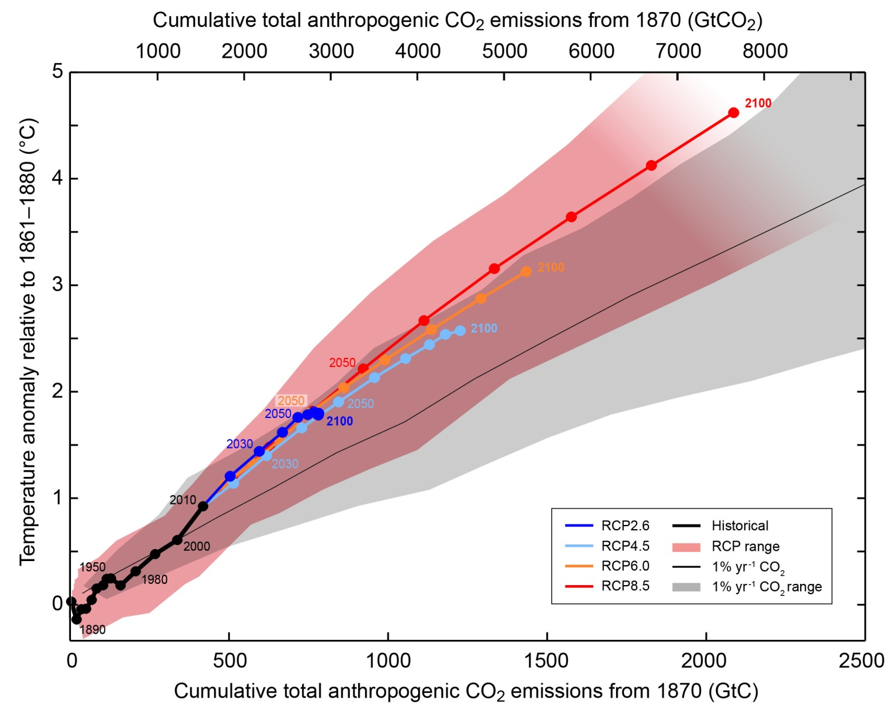
Where are we headed?
Temperature increase is proportional to accumulated emissions
Ice melt and sea level rise is already committed for many centuries into the future
Notes:
2005 Fung 19th+20th century cumulative is 276 Pg-C
A1B 1380 Pg-C 825 ppmv
A2 1732 Pg-C 993 ppmv
2013 IPSS WG1 Summary for Policy Makers figure SPM.10 on page 28
CO2 concentrations reaching 421 ppm (RCP2.6), 538 ppm (RCP4.5), 670 ppm (RCP6.0), and 936 ppm (RCP 8.5) by the year 2100.
Including also the prescribed concentrations of CH4 and N2O, the combined CO2-equivalent concentrations are 475 ppm (RCP2.6), 630 ppm (RCP4.5), 800 ppm (RCP6.0), and 1313 ppm (RCP8.5). For RCP8.5

Slide 74
Summary of Possible Impacts if we stay on Fossil Intensive Path
1 degree C (350 ppm, already committed to this rise in temperature) due to inertia of climate system.
Changes in glacial runoff, regional changes in food production
Arctic and glacial meltdown continues, reduction of northern sea ice.
2 degree C (450 ppm, 2030-2050)
Geologic analog is last interglacial, Eemian (125,000 years ago)
Severe damage to Arctic, alpine, and coral ecosystems
More frequent heat-waves causing local ecosystem emissions.
Sea-Ice albedo flip: ice (80% reflective) , ocean (5% reflective)
Snow/land albedo flip: Snow (80% reflective), vegetation (15% reflective)
3 degree C (550ppm, 2060-2090, +50 cm sea level)
Geologic analog is the Pliocene, 4 million years ago (+10C summers)
Australia burning, collapse of Amazon ecosystem, Permanent El Nino
Complete disappearance of Arctic summer sea ice.
Significant melting of tropical glaciers, loss of water sources in Andes, Asia.
Loss of Great Barrier Reef (home to 1500 species)
30% of global species at risk of extinction.
Risk that 650 Gt-C terrestrial biomass becomes a net source, due to soil moisture, plant stress, committing world to 4 degrees.
Notes:
Adapted from Six Degrees (Mark Lynas) and pg. 826 of IPCC wg1 & wg2 (impacts table)report, 2007
IPCC 2007 Physical Basis Table TS.5, pg. 66 (T vs Co2-eq)
best very-likely likely
CO2-eq est above in range
350 1.0 0.5 0.6–1.4 all T’s in C w.r.t. pre-industrial
450 2.1 1.0 1.4–3.1
550 2.9 1.5 1.9–4.4
650 3.6 1.8 2.4–5.5
750 4.3 2.1 2.8–6.4
1000 5.5 2.8 3.7–8.3
1200 6.3 3.1 4.2–9.4
+3C [Tedford 2003 Nature] Pliocene 4-5 Mya, treeline +2000 km, +10C summers
+2C [Matthews 2007 GRL] risk increases by 1.7 to 3.0
See special issue Jan. 2011 Proceedings of the Royal Society - A

Slide 75
Summary of Possible Impacts if we stay on Fossil Intensive Path
4 degree C (700 ppm, >2070, +2 meter sea level rise)
Mass starvation will be a permanent risk for much of the human race.
Significant melting of Greenland ice sheet and W.Antarctic ice shelf.
Risk of irreversible loss of permafrost (350-950 Gt-C) and
emission of methane/CO2, committing world to 5 degrees.
5 degree C (850 ppm, > 2090, +3 meter sea level rise)
Geologic analog is the Permian-Eocene Thermal Maximum, 55 million years ago
Ronne and Ross ice sheets (W. Antarctic) begin to melt (+5 meters SLR)
Risk of reduction/collapse in meridional overturning current
Risk of irreversible loss of ocean methane clathrates (1000’s Gt-C), committing world to 6 degrees
6 degree C (1100 ppm, > 2150) + 10 meter sea level rise
Geologic analog would be the Cretaceous period: 144 to 65 million or the End-Permian, 250 million years ago
Permanent loss of ice sheets at both poles, Rain forests have burned up and disappeared (10 meter SLR f/ E.Antarctic ice sheets)
30/50 US states will not be able to host state trees or flowers, how fast can wildlife and ecosystems migrate?
Notes:
Adapted from Six Degrees (Mark Lynas) and pg. 826 of IPCC wg1 & wg2 (impacts table)report, 2007
2007 Schulze +3C terrestrial biomass becomes net source
2006 Holland 2040 no ice in polar summer
2006 Federov +25 meter SLR, permanent El Nino
See impacts/tipping_point/envdef_meinshausen_summary.pdf for list of impacts at each temperature domain
Used Betts 2011 PTRSA for Temperature(time)
Archer 2005: 300 yr + 25% forever – hydrates release is most probable in distant future
30 cm/yr retreat of permafrost active layer. 1000’s Gt-C in ocean clathrates [Archer JGR 2006]
Net Global Vegetation is 650 Gt-C 950-970 Gt-C in Permafrost [Zimov 2006]
+5 meters (West Antarctic) + 10 meters (East Antarctic) is from 2002 NAS Abrupt climate change: Inevitable Surprises
+7 meters (Greenland) is from Schiermeier, Nature v.428, p.114
The movie “too hot to handle: all Alaska glaciers (+ 1 foot), all Greenland (+7 meters), all Antarctica (+145 feet)
+70 meters is Antarctica and Greenland completely melted (Alley, 2005 Science)
2007 GRL Matthews and Keith: Carbon cycle (terrestrial feedbacks) – increases probability of exceeding 2 C by factor of 1.7-3
Special issue on “6-degrees”
Anderson, K. and A. Bows 2011. Beyond 'dangerous' climate change: emission scenarios for a new world. Phil. Trans. R. Soc. Lond. A v.369 p.20-44.
Betts, R.A., M. Collins, D.L. Hemming, C.D. Jones, J.A. Lowe and M.G. Sanderson 2011. When could global warming reach 4 degC? Phil. Trans. R. Soc. Lond. A v.369 p.67-84.
Bowerman, N.H.A., D.J. Frame, C. Huntingford, J.A. Lowe and M.R. Allen 2011. Cumulative carbon emissions, emissions floors and short-term rates of warming: implications for policy. Phil. Trans. R. Soc. Lond. A v.369 p.45-66.
Fung, F., A. Lopez and M. New 2011. Water availability in +2 degC and +4 degC worlds. Phil. Trans. R. Soc. Lond. A v.369 p.99-116.
Gemenne, F. 2011. Climate-induced population displacements in a 4 degC+ world. Phil. Trans. R. Soc. Lond. A v.369 p.182-195.
Huntingford, C., P.M. Cox, L.M. Mercado, S. Sitch, N. Bellouin, O. Boucher and N. Gedney 2011. Highly contrasting effects of different climate forcing agents on terrestrial ecosystem services. Phil. Trans. R. Soc. Lond. A v.369 p.2026-2037.
New, M., D. Liverman, H. Schroder and K. Anderson 2011. Four degrees and beyond: the potential for a global temperature increase of four degrees and its implications. Phil. Trans. R. Soc. Lond. A v.369 p.6-19.
Nicholls, R.J., N. Marinova, J.A. Lowe, S. Brown, P. Vellinga, D. De Gusmao, J. Hinkel and R.S.J. Tol 2011. Sea-level rise and its possible impacts given a 'beyond 4degC world' in the twenty-first century. Phil. Trans. R. Soc. Lond. A v.369 p.161-181.
Sanderson, M.G., D.L. Hemming and R.A. Betts 2011. Regional temperature and precipitation changes under high-end (>= 4 degC) global warming. Phil. Trans. R. Soc. Lond. A v.369 p.85-98.
Smith, M.S., L. Horrocks, A. Harvey and C. Hamilton 2011. Rethinking adaptation for a 4 degC world. Phil. Trans. R. Soc. Lond. A v.369 p.196-216.
Thornton, P.K., P.G. Jones, P.J. Ericksen and A.J. Challinor 2011. Agriculture and food systems in sub-Saharan Africa in a 4 degC+ world. Phil. Trans. R. Soc. Lond. A v.369 p.117-136.
Warren, R. 2011. The role of interactions in a world implementing adaptation and mitigation solutions to climate change. Phil. Trans. R. Soc. Lond. A v.369 p.217-241.
Zelazowski, P., Y. Malhi, C. Huntingford, S. Sitch and J.B. Fisher 2011. Changes in the potential distribution of humid tropical forests on a warmer planet. Phil. Trans. R. Soc. Lond. A v.369 p.137-160.

Slide 76
Risk assessment & precautionary principle (burden of proof is essentially reversed)
Most probable forecast is that climate change will be very disruptive unless humans radically change their habits..
Economic and ecological systems are highly non-linear (“everything depends on everything else”) and may respond in unpredictable ways to small changes in climate (e.g., sea level rise, biosphere thresholds).
If extreme threat is real (5% chance ??) and we do nothing:
World will be disrupted in a way that can only have overwhelming negative consequences for future generations.
We can probably afford to be ignorant of small risks, but we cannot afford to misevaluate veritable catastrophes. There would be regrets.
Climate uncertainties are “asymmetric” with “long-tail” towards higher risk.
Future generations “pay the price” for our inaction.
There is a small chance (5% chance ??) that climate change will be manageable without human intervention. By taking action at this time:
There would be “no regrets”
Investment in carbon-neutral (sustainable) energy would be a benefit for other reasons (energy independence, economic growth, etc.)
By taking unnecessary action, who suffers?
Many trillion of $$’s will be left unexploited, economy might suffer.
Notes:
pg. 10 of IPCC07 Summary for policy makers "Most of the observed increase in global average temperatures since the mid-20th century is very likely (90%) due to the observed increase in anthropogenic greenhouse gas concentrations"
Risk assessment: Newsweek Sep. 3, 2007 – letters on pg. 18
Hansen in “the Seed”, Dec. 2006
Medium mitigation would save 5,470,000 bbl’s/day → $100 billion/year @ $50/bbl
- We make many decisions with lack of 100% certainty: Fire insurance, Diagnosing and treatment of diseases, etc
- Toggwieler+Russell 2008 – stronger overturning in ocean due to increased wind as it gets warmer. Wind is not represented in most models and combined effects of ozone hole (increasing southern winds), rapidity of warming (only surface whereas glacial era the entire ocean warmed) today could be significantly different than the past.
- Imagine if the Earth was your child: 1992: We measured the temperature and it was warm, 1999: We measured it again, and it was warmer. 2007: We proved that the increase in temperature was due to something we were doing. If this were a child would we be arguing about the diagnosis or would we try treatments?
- Climate discussion so far is like the following: Have you stopped beating your wife yet (yes/no)?
It will be difficult to diagnose the disease, forecast the development, prescribe the right drugs, and determine the correct dosage for treatment. Robert Harriss (Houston Advanced Research Center) Creating a climate for change: communicating climate change and facilitating social change. 549 pages Cambridge Univ. Press
high-impact low-probability catastrophes tend to be "fat tailed“
Weitzman, M.L. 2009. On modeling and interpreting the economics of catastrophic climate change. The Review of Economics and Statistics v.91 p.1-19
Weitzman, M.L. 2008. On modeling and interpreting the economics of catastrophic climate change. Harvard University www.nber.org/~confer/2008/si2008, 37 pgs.

Slide 77
Why is uncertainty asymmetric?
In short, humans cannot comprehend the exponential
We (our models) tend to linearize from present day conditions
Models may be missing important processes that come into play at higher temperatures or depend on complex interactions
This tends to underestimate the change (+ or -) that is occurring.
Some Examples
Terrestrial Feedbacks
Pests in Canadian boreal forest cause tree-mortality, increasing T
Increased tree mortality in western USA, loss of ecosystem services
Heat-waves lead to loss of soil moisture, leads to drought, fire
Feedbacks due to natural long-term carbon sequestration.
Warming causes CO2 emissions from Canadian & Siberian Peat Bogs
Indonesian Peat Bogs (drained for rice crops) increase emissions
Feedbacks due to Permafrost, Clathrates
Warming can cause accelerated melting of permafrost
New freeze mechanism causes clathrates to rapidly release methane
Notes:
Kurz, W.A., G. Stinsom, G.J. Rampley, C.C. Dymond and E.T. Neilson 2008. Risk of natural disturbances makes future contribution of Canada's forests to the global carbon cycle highly uncertain. Proc. Nat'l Acad. Sci. v.105 p.1551-1555.
2007 Pearce Speed and Violence Ch.12 – Borneo Peat Fires 880 tons/acre
van der Werf, G.R., J. Dempewolf, S.N. Trigg, J.T. Randerson, P.S. Kasibhatla, L. Giglio, D. Murdiyarso, W. Peters, D.C. Morton, G.J. Collatz, A.J. Dolman and DeFries R.S. 2008. Climate regulation of fire emissions and deforestation in equatorial Asia. Proc. Nat'l Acad. Sci. v.105 p.20350-20355. doi:10.1073/pnas.0803375105
Betts, R.A. 2008. Offset of the potential carbon sink from boreal forestation by decreases in surface albedo. Nature v.408 p.187-190.
van Mantgem, P.J., N.L. Stephenson, J.C. Byrne, L.D. Daniels, J.F. Franklin, P.Z. Fule, M.E. Harmon, A.J. Larson, J.M. Smith, A.H. Taylor and T.T. Veblen 2009. Widespread increase of tree mortality rates in the western United States. Science v.323 p.521-524
Page, S.E., F. Siegert, J.O. Rieley, H.-D. V. Boehm, A. Jayak and S. Limink 2002. The amount of carbon released from peat and forest fires in Indonesia during 1997. Nature v.420 p.61-66.
Cox, P. and C. Jones 2008. Illuminating the modern dance of climate and CO2. Science v.321 p.1642-1644.
Froese, D.G., J.A. Westgate, A.V. Reyes, R.J. Enkin and S.J. Preece 2008. Ancient permafrost and a future, warmer Arctic. Science v.321 p.1648-1648.
Khvorostyanov, D.V., P. Ciais, G. Krinner, S.A. Zimov, Ch. Corradi and G. Guggenberger 2008. Vulnerability of permafrost carbon to global warming.
warming. Tellus-B v.60 p.250-264 and p.265-275.

Slide 78
What is missing from models?
Lack physical glacial processes, such as ocean basal melt-induced thinning, moulins + basal sliding, sub-glacial lakes, calving models, brine permeability | More rapid and larger sea level rise (1+ meters/century)
Lack of southern ocean physics – cannot reproduce glacial/interglacial and cretaceous CO2. | Abrupt changes in ocean uptake of atmospheric CO2
Lack adequate wetlands models, cannot model glacial/interglacial methane. | Rapid changes in warming due to methane emissions.
Lack deforestation impact on global water cycle | Rapid loss in tropical forests
Lack effects of nitrogen limitation on CO2 fertilization. | Higher atmospheric CO2 than projected.
Cloud condensation nuclei affect by emissions of volatiles from trees | Warming could be amplified
Lack physical models and realistic concentrations of black carbon | Underestimate warming in southern Asia
Lack physical models of aerosol impacts on rate of warming (global “brightening/dimming”) | Overestimate warming in Europe.
Lack of microbial metabolism heat release (“dung heat” effect) Uncertainty in size of permafrost carbon storage, current est. 2x IPCC | Increased melt rate of permafrost (1700 Gt-C)
Vertical resolution to correctly model cloud feedbacks in low meridional T gradients. Horizontal resolution to model regional impacts | Increased warming of poles due to formation of PSCs
Notes:
Kirk-Davidoff, D.B., D.P. Schrag and J.G. Anderson 2002. On the feedback of stratospheric clouds on polar climate. Geophys. Res. Lett. v.29 1556 doi:10.1029/2002GL014659, 4 pgs. (need 10 mb vertical resolution of models for PSCs)
Philapona 2009 GRL global brightening on Europe T’s
Trees and cloud condensation nuclei (Kump 2008 Science, Llorens 2009 GRL (creataceous)
Microbial “priming” effect – Heimann 2008 Nature
Gruber 2008 Nature – global N cycle – limits terrestrial CO2 fertilization
- add to what's not in models
- permafrost melting, bubbling
neglect the contribution of induced drift (by fish) in theoretical models of the mixing efficiency (that is, Richardson number) would result in an order-of-magnitude underestimate [Dewar 2009 Nature v.460 p.581-582]
Katija, K. and J.O. Dabiri 2009. A viscosity-enhanced mechanism for biogenic ocean mixing. Nature v.460 p.624-626
[Kintisch 2009 Science] v.323 p.1546 Projections of climate change go from bad to worse, scientists report.
- latest estimate of the amount of carbon in Permafrost is 1.7 trillion tons, 2x the IPCC estimate
Landschutzer, P., N. Gruber, F.A. Haumann, C. Rodenbeck, D.C.E. Bakker, S. van Heuven, M. Hoppema, N. Metzl, C. Sweeney, T. Takahashi, B.
Tilbrook and R. Wanninkhof 2015. The reinvigoration of the Southern Ocean carbon sink. Science v.349 p.1221-1224.

Slide 79
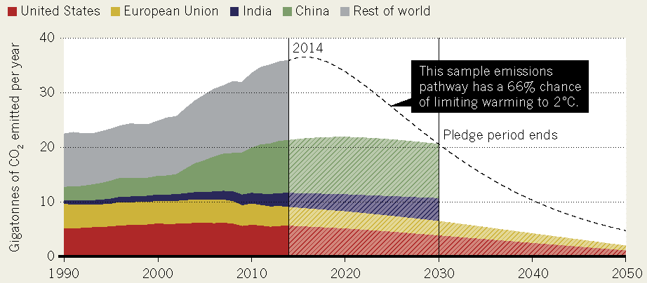
What happened in Paris
Nations proposed Intended Nationally Determined Contributions (INDC’s)
Europe: reduce CO2 emission by 40%(1990) by 2030
USA: reduce CO2 emissions by 26-28% (2005) by 2025
India: reduce CO2 emission intensity by 33 to 35% (2005) by 2030
But plans to double coal poduction by 2019
Completely voluntary
No penalties for failing to achieve commitment
Foundation is a commitment to transparency, may lead to global monitoring system
Even if all pledges are fulfilled, warming of 2.7 C (5 F) by 2100 is likely
Notes:
[Cornwall 2015 Science] Inside the Paris climate deal,12/18/2015 v.350 p.1451
Figure from Tollefson 2015 Nature, Nations adopt historic global climate accord, 12/17/2015 v.528 p.315-316
Pulla 2015 Science, Can India keep its promises?, 12/4/2015 v.350 p.1024-1027
Fauwcett 2015 Science, Can Paris pledges avert severe climate change?, 12/4/2015 v.350 p.1168-1169

Slide 80
Multiply “KWH Used” by ≈7.5 to get briquets emitted
Energy Source | Basic Conversion Facts | emission to atmosphere
Dish Washer | 1.1-2.2 kWh/load (80% of energy to heat water) | 7.5-15 briq/load
Conventional Oven | 65-100 kWh/month | 15 briq/day
Microwave Oven | 1.4 kW | 1 briquet every 6 min
Hot Shower | 2.5 gal/min, 70% 130F water | 1.3 briq/minute
2 cups boiling water | 59 F (15C) to 207 F (97 C) | 0.3 briquet
60 W light-bulb | 60W = 0.06 kWh/h | 0.4 briq/hr
60 W fluorescent | 15W = 0.015 kWh/h | 0.1 briq/hr
TV or Computer | 110 W | 0.75 briq/hr
Cable Box | 40W = 0.96 kWh/day | 7 briq/day
Small Chargers (phone, etc) | 1.5 W/h, 24/7 | ¼ briq/day/charger
Notes:
25% of consumer electricity goes to lighting, 60% for commercial Earth at night photo?
Energy required to heat 500 mL (16 oz, 2 cups) from 288K (15 C) to 370 K (97 C). Heat capacity of water is 4.184 J/ml/K, q=500 ml * 4.184 * (370-288) = 171544 J = 172 kJ
145 Watt* 1 hour = 145 J/s * 3600 s = 522 kJ/Briquet, therefore 0.3 briquets to heat 2-cups of water to boiling
Dish Washer uses about 12 gallons and takes 65 minutes. (10.3,45 mintes for short wash), 25 minutes for drying cycle
Toshiba SD-1800 DVD, 14 Watts
Dishwasher energy guide (based on 322 loads per year) ranges from 344 kWh/yr to 700 kWh/yr
Microwave: 1.4 kWh/h * 6.9 briquet/kWh = 9.66 briquet/hour, 9.66 briquet/hour * hour/60 minutes = 0.161 briquet/minute, 1/0.161 = 6.2 minutes/briquet
Hot Shower: 15C (60F) to 40C (130F), 3.7854 liters/gallon
q=2.5 g/m*3785.4 ml/g *0.7*4.184*(40-15) = 692,917.5 J = 692.9 kJ/522 kJ/briquet = 1.33 briq/min

Slide 81
Electricity is equivalent to briquets of carbon emitted at the power plant.
Energy Source | Basic Conversion Facts | Atmospheric Emission
Winter Electric Heating (1200 cu ft) | 1800 kWh/mn | 400 briq/day
9000 BTU Window Air Conditioner | <1340 W>, 321 kWh/mn | 70 briq/day
24,000 BTU Central Air Conditioner | <3570 W>, 857 kWh/mn | 190 briq/day
Ceiling Fan | 50 kWh/year | 1 briq/day/fan
Water Heater (without washer) | 300 kWh/mn | 65 briq/day
17 cu ft Refrigerator | 600-800 kWh/yr | 13 briq/day
Clothes Washer (+ hot water) | 250 Wh/mn, 6 kWh/load | 30 briq/load
Clothes Dryer | 5500 W, 30 min/load | 20 briq/load
Bigger homes ≡ more briquets for heating & cooling
Notes:
1 cal/gram to raise water 1 K, 4.184 J/cal
Energy required to melt ice is 80 cal/gram = 6.02 kJ/mole (18 g/mole)
Water heater settings are 100 F to 140 F (scalding hazard), save 3-5% energy costs per every 10 F lower in temp.
On web: use full washer loads and save 100 lbs-CO2/yr
lower thermostat 2 deg in winter and +2 deg in summer save 2000 lbs-CO2/ur

Slide 82
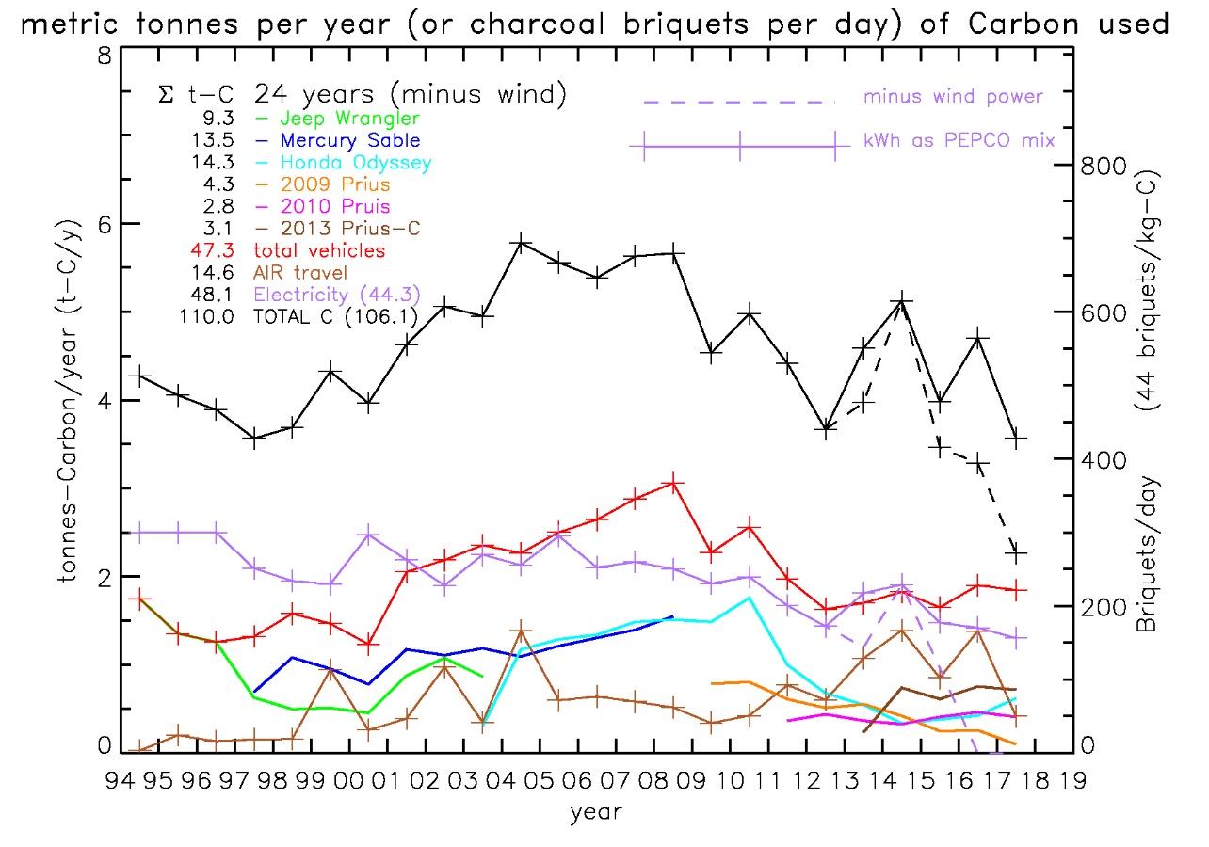
My personal carbon footprint (does not include indirect emissions)
Does include efforts to reduce consumption
changing to CFL light bulbs (2008-2010)
Does not include “indirect” footprint due to manufacturing, shipping, agriculture.
Biggest impact (so far) is replacing vehicles with hybrids and driving less.
Air travel is cause of recent increase
Kids
Prius
1 tonne-C/year ≅ 120 briquets/day
My family of 4 household energy (electricity & heat) use is about the same as total transportation (each ≅ 250 briquets/day
Indirect emissions (food, work, etc) would easily double our emissions
Notes:
6 t-C/y * (1000 kg/t * 44 briq/kg)/ (365 day/y) = 723 briquets/day
Prius #1 Jan. 3, 2009
Prius #2 Jan. 8, 2011
Prius #3 Aug.17, 2013

Slide 83
Population stresses many aspects of the environment
Industrial societies use 4-5 times as much energy as agrarian ones, which use 3-4 times the energy of hunting-gathering societies.
Need to recognize that human activities are indeed affecting the Earth system.
Stage 1: The industrial era (1800-1045)
Stage 2: The Great Acceleration (1945-2015)
Stage 3: Stewards of the Earth’s System (2016???)
Occurrence of abrupt or negative changes in climate becomes increasingly likely as the human disturbance of climate system grows (Karl 2009 USGCRP p.26)
Notes:
Steffen, W., P.J. Crutzen and J.R. McNeill 2007. The Anthropocene: Are humans now overwhelming the great forces of nature? Ambio v.36 p.614-621.

Slide 84
Percent of world emissions versus birth rate -Which countries would you pick to limit?
Eliminate emissions in the top 7 countries (33.1% of population) and world emissions reduce by 69%.
Eliminate 135 countries with high birth rate (58.9% of popularion) and world emissions reduce 14.9%.
Notes:
Figure generated by topics/carbon_data/cdiac/04emissions/04cdiac_nations.xls 196 countries are plotted: sources are 2004 CIA factbook (04cia_population.xls) and CDIAC national emissions data for 1751-2004 (items delimited by commas: nation,year,total,soild,liq,gas,cement,flaring,per-capita)

Slide 85
Does your choice have enough emissions to reduce emissions 80% by 2050?
Russia 144M
UK 60M
China 1300M
USA, 294M
France 62 M
India 1080M
Germany 83 M
Saudi Arabia 23 M
Japan 130 M
Nigeria 75M
Notes:
See 04cdiac_nations.xls 196 countries are plotted: sources are 2004 CIA factbook (04cia_population.xls) and CDIAC national emissions data for 1751-2004 (items delimited by commas: nation,year,total,soild,liq,gas,cement,flaring,per-capita

Slide 86
Biosphere is complex and non-linear: “everything is a function of everything else”
Increasing
CO2
Increasing
Temperature
Changes in
Ecosystems
(Ocean+Land)
Increasing
Atmospheric
Moisture
More
Energetic
Atmosphere
Increasing
Ocean
Temperature
Sea & Glacial
Ice Melt
Changes in
Length of
Seasons
Regional
Precipitation
Changes
More
Intense
Storms
Increasing
Sea Level
Melting
“Permafrost”
Changes in
River Runoff
& Wildfires
Physiological
Forcing
(Crop Yields)
Coastal
Erosion &
Flooding
Changes in
“Gulf Stream”
Increased
Atmospheric
CH4
Temperature is very difficult to measure (0.1 C/decade), we may see other changes first.
Notes:
Drought
Forest Fires
Mosquito Borne illnesses
CO2 → Ocean Acidification -> Biology
Habitat Changes - 070917_fahrenthold.pdf – habitat changes in Chesapeake
2005 Foley Vegetation Feedback in Arctic: 2.5 day/decade less snowcover, warming of 0.3-0.4 C/decade since the 1990’s, northward shift of vegetation increases temperature by 1.1-1.6 C

Slide 87
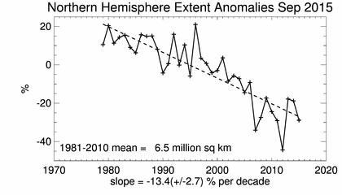
Northwest Passage opened for the 1st time in 3 million years.
Typical Arctic ocean ice in March covers 16 million km²
is only a few feet thick
Extent of summertime ice has been decreasing steadily from 7.5 million km² in late 1970’s to 6 million km² recently.
2012 had record low amount of sea ice – 3.41 million km² on Sep. 16.
2013/14 recovered slightly but long term trend is -13%/decade
Ice-free Arctic summers are predicted by mid-century – maybe within 30 years.
Shortens distance for shipping, e.g. Tokyo to London
9,950 via Northwest passage
13,000 miles via Suez canal
14,300 miles via Panama
Open water allows more ocean heat exchange with atmosphere
a positive feedback
Notes:
USA = 9.629 million km^2
Europe = 4.423 million km^2
Loss is 40% of CONUS (Tang 2014 Nat.CC)
[Cressie, 2007 Nature]
US Nat'l Snow and Ice Data Center (NSIDC), Boulder: 2005: 5.32 million sq.km, 2007: 4.24 million km
NSIDC 9/17/09: Sep. 12, 2009 minimum ice was 5.10 million sq.km, 580,000 km^2 greater than 2008, 970,000 km^2 above 2007
N.H. Extent Anomalies from NSIDC Sea Sice Index page: http://nsidc.org/data/seaice_index/
Feb. 2006 BAMS – Tokyo to London distances, Canadian sovereignty - potential for oil, nat’l gas, gold, diamonds, copper, and zinc.
1985: US ice breaker, Polar-sea a US coast guard ice breaker caused diplomatic dispute w/ Canada
9/10/1985: Canada claim to sovereignty to waters around arctic archipelago (16,000 islands)
1/25/2006: US ambassador to Canada "we don't recognize Canada's claim to those waters" David Wilkins
4/10/2006: Canadian forces completed a 2-week exercise designed to assert sovereignty over the arctic. 2800 miles by snowmobile (2100 NW of Ottawa, 555 miles N of arctic circle)
[Comiso, 2008, GRL] SMMR/SSM/I data
extent=4.1E6 km^2, area=3.6E6 km^2 24% and 27% lower than previous lows (37%,38% w.r.t. climatology)
trend 1979-1996: -2.2%/decade (extent), -3.0%/decade (area)
trend 1996-2007: -10.1 +/- 0.7%/decade (extent) and -10.7 +/- 0.8%/decade (area)
Wang, M. and J.E. Overland 2009. A sea ice free summer Arctic within 30 years?. Geophys. Res. Lett. doi:10.1029/2009GL037820, 18 pgs.

Slide 88
Climate deniers say previous slide misrepresents the global sea ice
Antarctic sea ice has shown little change in last 30 years.
Most of southern sea ice is at edge of continent (north of 75 S)
Loss of Arctic sea ice (north of 75 N) can dramatically alter radiation balance.
Melting of Arctic sea ice may have more to do with feedbacks (e.g., ocean, soot) than CO2
Notes:
Figure from NSIDC (Boulder)
Soot and Arctic melting:
Hansen, J.E. and L. Nazarenko 2004. Soot climate forcing via snow and ice albedos. Proc. Nat'l Acad. Sci. v.101 p.423-428.
McConnell, J.R., R. Edwards, G.L. Kok, M.G. Flanner, C.S. Zender, E.S. Saltzman, J.R. Banta, D.R. Pasteris, M.M. Carter and J.D.W. Kahl 2007. 20th-century industrial black carbon emissions altered arctic climate forcing. Science v.317 p.1381-1384.
Also affects Tibetan glaciers:
Xu, B., J. Cao, J. Hansen, T. Yao, D.R. Joswia, N. Wang, G. Wu, M. Wang, H. Zhao, W. Yang, X. Liu and J. He 2009. Black soot and the survival of Tibetan glaciers. Proc. Nat'l Acad. Sci. v.106 p.22114-22118.

Slide 89
Is Recent Extreme Weather Due to Climate Change?
Region | Event | Attribution
Central USA Drought | 2011-12 was most extreme since 1950’s | Natural Variability
USA heatwave | 2012 was warmest USA T’s on record | 5-12 times more likely due to warming climate
Arctic Sea Ice | 2012 record minimum | Unlikely to have occurred naturally
Greenland Ice-Sheet | 98.6% of surface melted | Natural variability
Heatwave in Africa | Drought in Somalia | Tele-connection with warming in W. Pacific
Summer 2012 Europe | Extreme rain in Britain Droughts in Spain | Natural variability (SST) More likely due to T
Flooding in China/Japan | 11 rain records in 2012 | Natural variability
Analogy: driving your car a few more miles/hour makes accidents more likely, but the cause of the accident will still be weather, texting, etc.
Notes:
Peterson, T.C., M.P. Hoerling, P.A. Stott and S.C. Herring 2013. 1. Explaining extreme events of 2012 from a climate perspective. Bull. Amer. Meteor. Soc. v.94 Supplement, S1-74, 104 pgs.
Hanna, E., X. Fettweis, S.H. Mernild, J. Cappelen, M.H. Ribergaard, C.A. Shuman, K. Steffen, L. Wood and T.L. Mote 2013. Atmospheric and oceanic climate forcing of the exceptional Greenland ice sheet surface melt in summer 2012. Int. J. Climatology 10.1002/joc.3743(in press),
Peterson, T.C., P.A. Stott and S. Herring 2012. Explaining extreme events of 2011 from a climate perspective. Bull. Amer. Meteor. Soc. v.93 p.1041-1067.
IPCC, C.B. Field and et al. 2012. Managing the risks of extreme events and disasters to advance climate change adaptation, a special report of WGs I and II. Cambridge University Press 594 pgs.

Slide 90
IPCC 5th assessment report
Intergovernmental panel on climate change (IPCC) was formed 25 years ago
1990 1st report: emissions increasing GHG will result in additional warming (my paraphrase of their words)
1995 2nd report: “balance of evidence suggests a discernible human influence on global climate”
2001 3rd report: “most of the observed warming over last 50 years is likely (66% chance) to have been due to increase in GHG”
2007 4th report: “most of the observed increase in global average temperatures since mid-20th century is very likely (90% chance) due to increase in anthropogenic GHG”
2013 5th report: “it is extremely likely (≥95% chance) that human influence on climate has caused more than half of the observed increase in global temperature from 2051-2010.”
Change in attribution is due to (a) more observations, (b) better understanding, (c) continued increase in GHG causing more pronounced changes
2013 report has 830 authors (250 lead authors) with 3 working groups (science, impacts, mitigation) covering a wide range of climate topics. See: http://www.ipcc.ch/
Notes:
Nature v.501 Sep. 19, 2013 p.297-300
IPCC home page: http://www.ipcc.ch/

Slide 91
To assess the meaning of probabilities we need to also assess the consequences
In USA, the chance of you dying in a car accident is roughly 1:100.
Odd of dying in an airline crash (odds of 1:20,000) because 100’s are affected in a single event.
Even less likely that you will die from a flood (1:30,000) or tornado (1:60,000).
Asteroid impact (10 km dia) is low-probability but can affect billions.
What makes climate change difficult to discuss is it relates to future generations
millions, possibly billions of the world’s future population may be severely impacted.
affects all lifeforms on Earth
Climate Change
?
Notes:
Figure from Chapman, C.R. and D. Morrison 1994. Impacts on the Earth by asteroids and comets: assessing the hazard. Nature v.367 p.33-40.
Table 3: Chances of dying from selected causes (USA)
Motor vehicle accident 1:100
Murder 1:300
Fire 1:800
Firearms accident 1:2,500
Electrocution 1:5,000
Asteroid/Comet Impact 1:20,000
Passenger aircraft crash 1:20,000
Flood 1:30,000
Tornado 1:60,000
Venomous bite or sting 1:100,000
Asteroid/Comet impact (upper limit) 1:250,000
Fireworks accident 1:1,000,000
Food poisoning by botulism 1:3,000,000
Drinking water with EPA limit of trichloroethylene 1:10,000,000
Tonn, B. 2010. Preventing the next mass extinction: Ethical obligations. J. Cosmology v.2 p.334-334.
[Campbell 2008 Brookings]
- threat of attack from USSR - spent a lot of money, low risk → climate change is larger
- greatest threat comes from uncertainty
- no precedent in human history for a global disaster that affects whole societies in multiple ways at many different locations
- Approximate Maximum Mortality Levels
Volcanic Eruptions 10^4 6 have killed > 1E4
Earthquakes 10^5 10 have killed > 1E5
Floods 10^6 1954 Yangtze 3E4, 1931 Yangtze 1-4E6
Droughts 10^7 1928-31,36,41 China 2-4E6 each
Epidemics 10^8 1918 influenza 40E6, AIDS pandemic 25E6
- 6/2007 Cyclone Gonu, 1st cat.5 hurricane documented in Arabian Sea, halted shipping through the Strait of Hormuz, primary artery
for Persian Gulf Oil

Slide 92
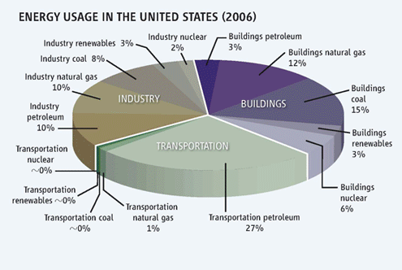
In USA, Improving energy efficiency can dramatically lower emissions
The “Prius Effect”: Knowledge of where energy is used leads to cost savings and lower emissions
The real potential of energy efficiency is not going to be realized until we get away from the idea that is has to pay for itself.
Landlords buy inefficient appliances because renters pay utilities
“Energy star” technologies aimed at higher end customers.
Notes:
Figure from Charles, D. 2009. Leaping the efficiency gap. Science v.325 p.804-811.

Slide 93
Peak oil, gas, and coal
Consumption of fossil fuels has increased exponentially
Population and economic growth are both exponential increases that drives increasing demand for fossil fuels
Easy to extract (i.e. low cost) oil, gas, and coal are finite resources.
Hard to extract oil (off-shore, oil-sands), natural gas (shale gas), and low-grade coal is abundant, but these fuels are lower energy density and extraction will be depend on economic viability (and subsidies)
Also have higher emissions of CO2 and CH4 for the same work done
When roughly 1/2 of economically viable oil is consumed the price of oil will "de-couple" from production
Last decade price of oil varied by factor of 3
Production (≈85 million barrels-oil/day) did not change
Fossil fuels may not be able to fuel the 21st century in the manner to which we have become accustomed
Will fossil fuels remain low cost in future?
Will the price of fossil fuels be predictable?

Slide 94
Or make Bio-char?
Simple and stable form of carbon with low risk from leakage.
50% of green tree mass is water.
Wood combustion is carbon neutral and can be used to make charcoal.
Fast growing species could be harvested.
Low cost storage with long residence times (> 1000 years)
Becomes viable at $35/t-CO2.
1 Gt-C/yr is possible using waste biomass.
Forest residue f/ timber production, biofuel production, deforestation, etc.
Fast growing vegetation on idle cropland.
Historically, the DC area was big on biochar - Elizabeth Furnace in George Washington national forest – turn of the century wood furnaces.
Notes:
Lehmann, J. 2007. A handful of carbon. Nature v.447 p.143-144.
Lehmann, J., J. Gaunt and M. Rondon 2006. Bio-char sequestration in terrestrial ecosystems - a review. Mitigation and Adaptation Strat. Global Change v.11 p.403-427. doi:10.1007/s11027-005-9006-5
3) Marris, E. 2006. Black is the new green. Nature v.442 p.624-626.
4) McCarl, B.A. and U.A. Schneider 2001. Greenhouse gas mitigation in U.S. agriculture and forestry. Science v.294 p.2481-2482.
5) Klaus H. Hemsath 2007 Climate Change: Gold Rush or Disaster?
6) Molina, M., D. Zaelke, K.M. Sarma, S.O. Andersen, V. Ramanathan and D. Kaniaru 2009. Reducing abrupt climate change risk using the Montreal Protocol and other regulatory actions to complement cuts in CO2 emissions. Proc. Nat'l Acad. Sci. v.106 p.20616-20621. - biochar (3.67 Gt-C/yr using waste biomass), reforestation (5 Gt-CO2e/yr), afforestation (1 Gt-CO2e/yr)

Slide 95
Dietary choices make a difference Typical US diet emits 50 briquets/person/day
Food production used 17% of all fossil fuels in 2002
Farm Equipment
Fertilizer
Ships & Trucking
Refrigeration
The average US diet (3774 kcal/day), 27.7% from animal sources) adds 1.485 ton-CO₂/person/yr (=50 briquet-C/person/day) into the atmosphere, relative to a locally grown vegetarian diet – equivalent to driving a 25 m/g vehicle versus a 55 m/g Prius (8,332 miles/person/yr). From Eshel & Martin, 2006Earth Interactions v.10 p.1-17.
Notes:
1.485 ton-CO2*2200 lbs/ton * 12/44 C/CO2 * 1/365 yr/day * 20 briq/lb = 48 briq-C/day
8332 miles/person/yr * 1/365 yr/day * 3.3 briq/mile (30 m/g) = 75 brig/person/day
Cargo Ship 15 grams CO2 per ton/km
90,000 cargo ships world-wide – have no emissions standards + shipping due to international trade is increasing. ABC news 10/19/2007
http://timeforchange.org/co2-emissions-shipping-goods
Air plane (air cargo), average Cargo B747 500 g-CO2 per metric ton per km Modern lorry or truck 60 to 150 g-CO2 per metric ton per km Modern train 30 to 100 g-CO2 per metric ton per km
Modern ship (sea freight) 10 to 40 g-CO2 per metric ton per km Airship (Zeppelin, Cargolifter ) as planned 55 g-CO2 per metric ton per km

Slide 96
Biomass Burning will continue as long as carbon in trees is considered worthless.
Many countries slash and burn forests to support agriculture for food and biofuel production.
Since 2006 US corn production rose 19% and soy production fell 15%
Soy prices doubled, deforestation and fire incidence increased dramatically in Brazil to support economically viable soy market.
Indonesia burned forests to support biofuel production for world market (images at right)
Study suggests a carbon tax of $9/t-CO2 would reduce deforestation 10-50% (0.1 to 0.7 Gt-C/yr)
Brazilian deforestation down 73% (7,464 km² in 2009) from 27,400 km² in 2003/2004
In part, due to $1 billion pledge from Norway
Notes:
Figures:
1) biomass_burning_indonesia.gif
2) indonesia_sts048_71_090.jpg
3)
Gullison 2007 Science
Feb. 11, 2008 Newsweek – George Will comments on Indonesia biomass.
[Kindermann 2008 PNAS] Reduced C emissions from deforestation - $9/t-CO2 * 3.67, 0.5 to 2.5 Gt-CO2/yr
[Laurance 2007 Science] Switch to Corn promotes Amazon deforestation
since 2006 US corn production risen 19%, soy production fell 15% soy prices doubled in 14 months
Brazil, world's 2nd leading soy producer, had sharply increasing deforestation and fire incidence in recent months in the soy producing states and no increase in states with little soy production.
080926gcp_carbonbudget07.ppt 2007 was 8.5 Gt-C FF emissions + 1.5 Gt-C deforestation (0.6 America’s, 0.6 Asia, 0.3 Africa)
Tollefson Nature 11/25/2010 v.468 p.488-489 Climate talks focus on lesser goals
- encouraging news: deforestation in the Brazilian Amazon has slowed: Last year, it dropped to 7,464 km^2, down 73% from a 2003/2004, peak of 27,423 km^2
- Norway made a US$1-billion pledge, about 200 million tonnes of emission reductions at current carbon prices
- image of “The Deforestation Decline”
Friedlingstein Nat. Geo 12/2010 – 1990-2000 1.6 +/- 0.7 Gt-C/y, 2000-2009 1.1 +/- 0.7 Gt-C/y

Slide 97
What would a $25/ton-CO₂ carbon tax cost?
Fuel Type | Increase | Increase (%) | Dividend in USA | Per-capita dividend
Nuclear | < $0.1/MWh | < 1% | $0.9 billion/yr | $2/yr
Coal-IGCC w/ CCS | $2.5/MWh | 2% | n/a | n/a
NGCC | $12.5/MWh | 11% | $10 billion/yr | $30/yr
Pulverized Coal | $20/MWh | 17% | $60 billion/yr | $200/yr
Gasoline | $0.21/gallon | 8% | $81 million/day $30 billion/yr | $100/yr
Nat’l Gas f/ Residential Heating | $1.27/MBTU | 11% | $6 billion/yr | $20/yr
Notes:
Farrell, A.E. 2007. Testamony to the house subcommittee on energy and air quality, April 18, 2007. (not published) 15 pgs.
- 4/18/07 testamony assume $0.1144/kWh and $2.50/gallon for %
99.2 GWe capacity of nuclear = 870 TWh/year
EIA 2009. Annual energy outlook 2009 with projections to 2030. U.S. Department of Energy DOE/EIA-0383(2009), 230 pgs.
p.187 Electricity from coal is 2002 billion kWh, Natural Gas 814 billion kWh
p.192 NGCC 6.87 TCF = 7.06e15 BTU = 2070e9 kWh * efficiency = 814 billion kWh if efficiency = 39%
4.72 TCF for residential heating * 1028 BTU/CF = 4.85e9 MBTU
p.193 9.29 million bbl/yr for motor gasoline * 42 gallons/barrel
unintended consequences. If you only tax fossil fuels... target of 450 ppmv cause bioenergy crops to expand to displace virtually all the world's natural forests and savannahs by 2065, releasing up to 37 Gt-CO2/year (Wise 2009, Science 324, 1183)

Slide 98
How much mitigation do we get if we stabilize at 450 ppmv by 2100?
 | Without mitigation | With mitigation
CO2 in 2100 | 740 ppmv | 450 ppmv
Global Surface Temperature | +2.2 C | +0.6 C
Arctic Temperature | + 5C | + 2 C
Sea Level Rise | +22 cm | +14 cm
N.America precipitation | +5 to +15 % | +3 to +8 %
Arctic Sea Ice Extent | -75% | -24% and stabilized to 6.5 million km2
Near Surface Permafrost | -70% | -45%
Intensity of Heat Waves |  | Half, mostly in W.USA, Europe, N.Africa
Notes:
Washington, W.M., R. Knutti, G.A. Meehl, H. Teng, C. Tebaldi, D. Lawrence, L. Buja and W.G. Strand 2009. How much climate change can be avoided by mitigation? Geophys. Res. Lett. v.36 L08703 doi:10.1029/2008 GL037074, 5 pgs
- climate sensitivity = 2.7 K/2xCO2

